Slide 1
Job Satisfaction & Work Life Balance
Do you want to derive more satisfaction from your career by being proud of the work you are producing due to positive feedback from subs, suppliers, clients and your peers?
Do you want to have a better work life balance where your family, hobbies, and other interests can have more time allotted distraction free from work issues?

Slide 2
Scheduling and Training
By Adam Flood
Designed by David Caraccio
Judged By Colin Bragg
A 2020 case study showed that 70% of all construction projects fail to deliver what was promised to customers.
Of this only 25% were delivered within 10% of the original timeframe.
A lack of clear goals & objectives accounts for 37% of these failures.

Slide 3
AnCor’s Approach for Project Delivery is to be solutions based and schedule driven.
“Failing To Prepare is Preparing To Fail!”

Slide 4
How we will achieve this?
Forecasting
Increased interaction w internal office departments, field and remote offices
Utilizing multiple scheduling methods
Weekly Meetings
Accountability

Slide 5
Scheduling Facts
Schedules are to be realistic based on the current market conditions but we also must remain competitive to obtain jobs.
It is the responsibility of AnCor to set the tone of urgency to avoid project complacency.

Slide 7
Importance of scheduling
Improving workflows and streamlining projects
Enhancing communication between all parties
Managing the buying of materials and critical elements on time and in sufficient quantities
Achieving the highest level of productivity to complete the project within the targeted timeline and budget

Slide 8
Importance of scheduling
Improving the planning of resources, including a project’s workforce
Maximizing quality control measures
Prioritizing work schedules according to varying conditions
Takeaway - It is critical to document these and adjust the schedule/general conditions accordingly

Slide 9
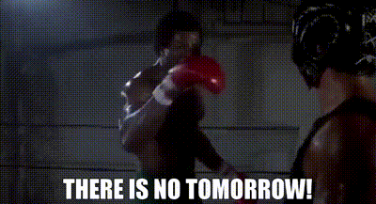
Schedule Fade
At the beginning of a project spanning several months losing a week here and there is easy as you believe it will be made up overtime.
Murphy’s Law was most likely written by a construction professional.
“Anything that can go wrong will go wrong”.

Slide 10
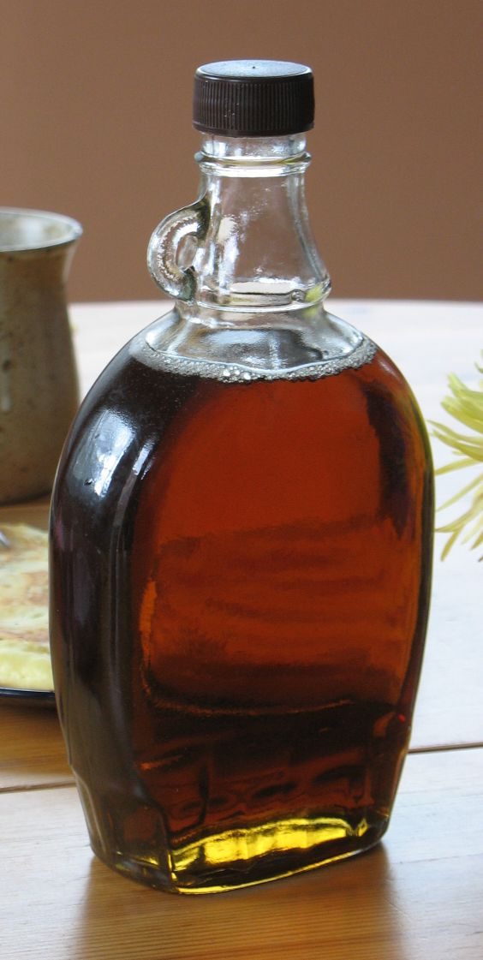
“Steady your shield, ready your axe raid the day”
– Unknown, But Some Smart Canadian Most Likely

Slide 11
Client Expectations
Clients TYPICALLY DO NOT track the SCHEDULE until their obligatory dates are approaching.
A gentle reminder in writing regarding General Conditions goes a long way in creating a sense of urgency in clients.
Doing This having a clear reference showing what the schedule goals were vs the impact make the conversation with the client much easier and fact based

Slide 12
Creating & Uploading a Schedule
Refer to below link to AnCorU
https://wixlabs-pdf-dev.appspot.com/assets/pdfjs/web/viewer.html?file=%2Fpdfproxy%3Finstance%3DWrJ-q0JQlrW-ELNZhrIHC5ywLSBtCVfAnnVNkDyxsBg.eyJpbnN0YW5jZUlkIjoiNzA4NTliZTAtNjdhZS00ZTIzLWExZDItZWQ1MWQyZDYyYjU1IiwiYXBwRGVmSWQiOiIxM2VlMTBhMy1lY2I5LTdlZmYtNDI5

Slide 13
Schedules Types Used by AnCor
Milestone Method
Critical Path Method
Two week lookahead
Day by Day

Slide 14
PM Responsibilities When Creating a Schedule
Understand the client expectations?
Understand the plans and scope of work.
Understand the required manpower commitments
What items have long lead and how will it impact project delivery?
What work can occur concurrently or out of tradition sequence?
Can a permit be issued in phases?
Notes:
PM Responsibilities When Creating a Schedule
PM Responsibilities When Creating a Schedule

Slide 15
Preconstruction Scheduling Process

Slide 16
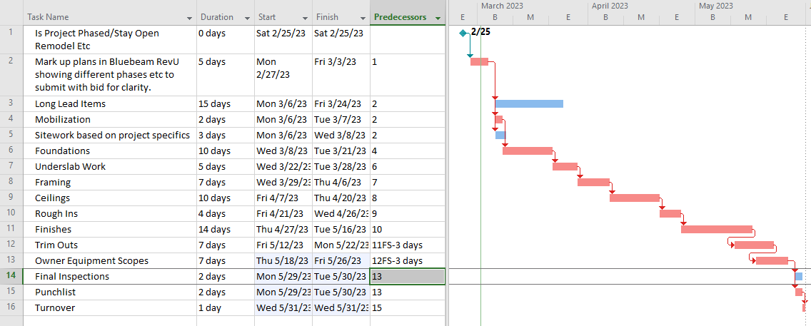
During the bidding phase a PM is to put together a milestone schedule showing the following:

Slide 17
Support Staff Project Schedule Responsibilities
Review
Review landlord rules and regulations.
Review
Review work letter exhibit in lease
Understand
Understand required submittals
Assist in
Assist in identifying long lead items

Slide 18
Schedule Process in Construction
Upon Project Award the Project Manager is to update the milestone schedule to a critical path schedule.
The Critical Path schedule takes the milestones and breaks then down further being trade specific

Slide 19
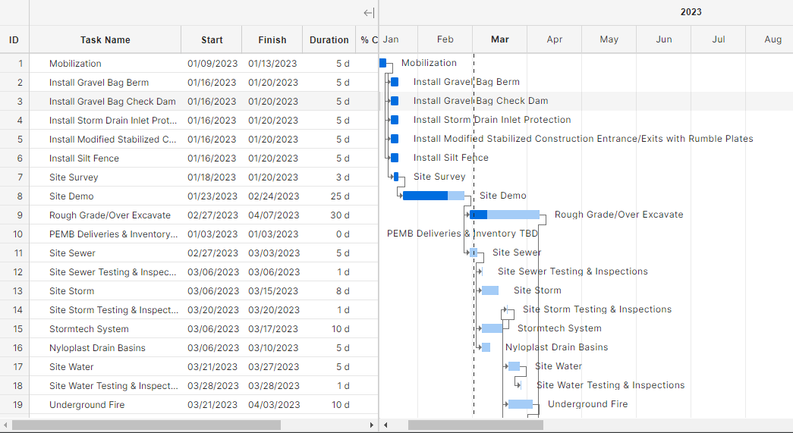
Werner Phase 2: Critical Path

Slide 20
Schedule Process from the Field Perspective

Slide 21
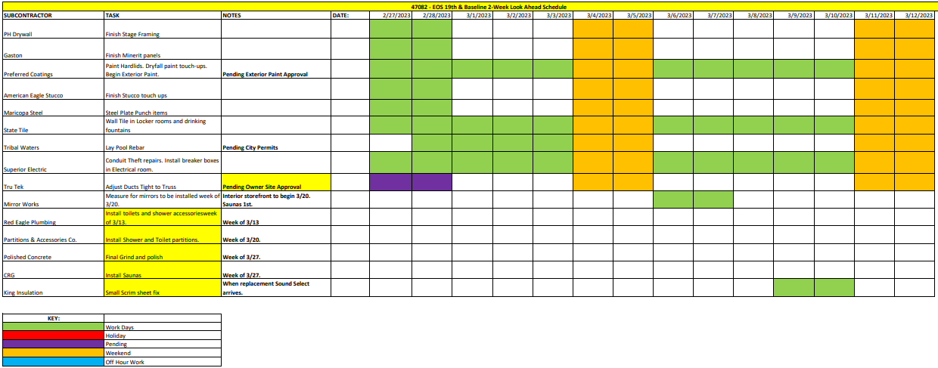

Slide 22
This method of scheduling should be completed via a weekly coordination meeting with all subcontractors where they can bring their concerns to the table and work together to either solve them or coordinate their work.

Slide 23
Field Coordination Example

Slide 24
Several subcontractors are scheduled to work in the same area and their work if not properly coordinated will cause substantial issues.
Multiple subs working in a locker room during rough in – This would involve the framer, electrician, plumber, HVAC, sprinkler & fire alarm sub
At the meeting pencil out how many days the trades will need for his overhead work above ceiling. This should trigger a thought of ensuring all overhead work is complete prior to painting the open ceilings and an e-mail should go to the project team reminding them of the date ceiling painting will commence.
Review a floor plan on Procore and markup any duct runs that will impact the framing and discuss the timeframe for the HVAC contractor to complete his work.
Now the framer has a clear path to work in these areas.

Slide 25
Taking these 30 minutes of coordination can save days of lost time and thousands of dollars of rework. Imagine if the framer started his work first and the electrician lost access to the roof deck and the HVAC sub had to cut opening in his walls to allow for duct penetration.

Slide 26
Schedule Process During Times of High Activity or Approaching Critical Path Dates It’s not how hard you look at things, it’s how you look at them.
Think simplicity at this point

Slide 27
Sample Day By Day Schedule
WEDNESDAY DECEMBER 1
Group Ex Mirrors Complete
Spin Room Mirrors Complete
Complete Mirrors in Gym Area
Super to Obtain Signoff on Plaster Colors & Marked Up Elevations from Designer
Scratch Coat Inspection In Spa Area
Continue Setting Shower Plumbing Fixtures & Drinking Fountains.
Cardio Cinema Grid Complete
Drop Sprinkler Heads in Cardio Cinema
Sauna Wood Doors Complete, Wood Complete
Commence W Tile In Steam Rooms/Sauna
Commence W/ Drywall Fur-out in Laundry Rooms and 1st coat mud/tape
Complete plumbing re-work at pool
Finish Coping Brick
Prep for Friday Concrete pour.
Steam Room waterproof complete (Yesterday).
Weld Fence Frames
Sand – 1st Coat Paint In Locker Rooms
Weld Locker Room Door Closed
T-Stat Install To Run Units
Install Group Ex 2X2 Lights
Continue Paint In Kid’s Club
Clean Rubber Continue
Toilet Accessory Install
Stainless Wainscot Install
Finalize Base Change Order W/ Pacific Tile
Order Tile Base
Prep Kid’s Club Sidewalk

Slide 28
Continued Day By Day Example
THURSDAY DECEMBER 2,
Install 2X2 Light’s in Kid’s Club
Glasstech to install Door Frame 109 & GP-13
2nd Coat Mud/Tape Laundry Room
Locker Install Commence
AnCor Super – Pick-up foam to wrap lockers with after install.
Complete Weld Fence Frames
Continue Locker Rooms Paint
Kid’s Club Paint Continue
Install Exterior Kid’s Club Door
Patch Drywall
Finish Toilet Accessory Install
Stainless Wainscot Install Complete
Cut Bollard At Fence
Stain Crews Remobilize To Fix Color - Afternoon

Slide 29
Continued Day By Day Example
FRIDAY DECEMBER 3,
Install Cardio Cinema Glass
Start chain link – Work Weekend.
Complete Locker Room Paint
Competition Hardwood Floors – To allow wood proper time to acclimate start installing Kid’s Club Rubber/Carpet Afternoon
Water Fountain Guard Install
Stain Crew Continue

Slide 30
Ideas to Motivate Subs on Improving Schedule Performance
As mid-month approaches remind the subs that the more work they get done in the next 10 days the more they can invoice for on the 25th of the month. This is particularly motivating to PM’s and Executive team members.
Recommend trades that need wide open spaces to work weekends. Trades such as tile/paint can complete a lot of work with no interruptions and will often times agree to the weekend work if scheduled far enough in advance.

Slide 31
Contractual References to Meet Schedule
Our contracts have numerous mechanisms to enforce project schedule. They are outlined below;
Section 2.3 – Subcontractor is to cooperate with contractor in scheduling the work.
This section states that if there is something that is going to impede the subs’ ability to deliver the project it is their obligation to bring it to our attention.
Section 2.5 – Subcontractor to employ such labor to the satisfaction of the contractor and work in harmony.
This section ensures are subs have properly trained manpower onsite and that they are working together as a team.
Paragraph 3 – Changes in the work
This paragraph states that the contractor is responsible to perform the work per plans and specs and not deviate until given written notice and receive approval.
Section 12 – Liquidated Damages/Dispute Resolution
This section outlines how we are to handle a dispute with the subcontractor and provides a mechanism for us to notice the contractor and then begin supplementing their work at no additional cost to AnCor.
This section also outlines the costs that can be back charged to contractors for not meeting the schedule.
Exhibit B – Work Schedule
Exhibit D – Construction Requirements
Numerous references are made to the schedule in this with associated fines. Please always keep a copy of this onsite to reference and show subcontractors.

Slide 32
Feeling After Referencing Contractual Requirements Without Fighting the Subs to Get them to Comply

Slide 33
Importance of General Conditions & Tracking
AnCor creates a schedule of values (insert Division 1 of budget) based on the number of weeks of the project.
This has a unit cost per week for supervision, PM and admin.
During the Thursday deep dive accounting meetings, the Project Team will be asked to review the base bid general conditions, the approved general conditions based on approved or pending ORCA’s

Slide 34
A project that is schedule driven is not only a successful project but far less stressful for the team.
When expectations are outlined in writing and backed up by contractual obligations disputes go from arguing to AnCor outlining consequences.
Often when presented with a fact pattern in line with an executed contract the subcontractor will work on resolving the issue instead of arguing.

Slide 35
Example of feelings after a successful project delivery!

Slide 36
Homework Component
All PM’s/APM’s/Supers for the week of 3.6 – 3.10 are sketch out a day by day schedule that will be distributed to the subs on 3.6 and tracked each day with the team. At the end of the week the team is to prepare a summary of what their findings were with this approach to a project to discuss with Adam.

