Slide 1
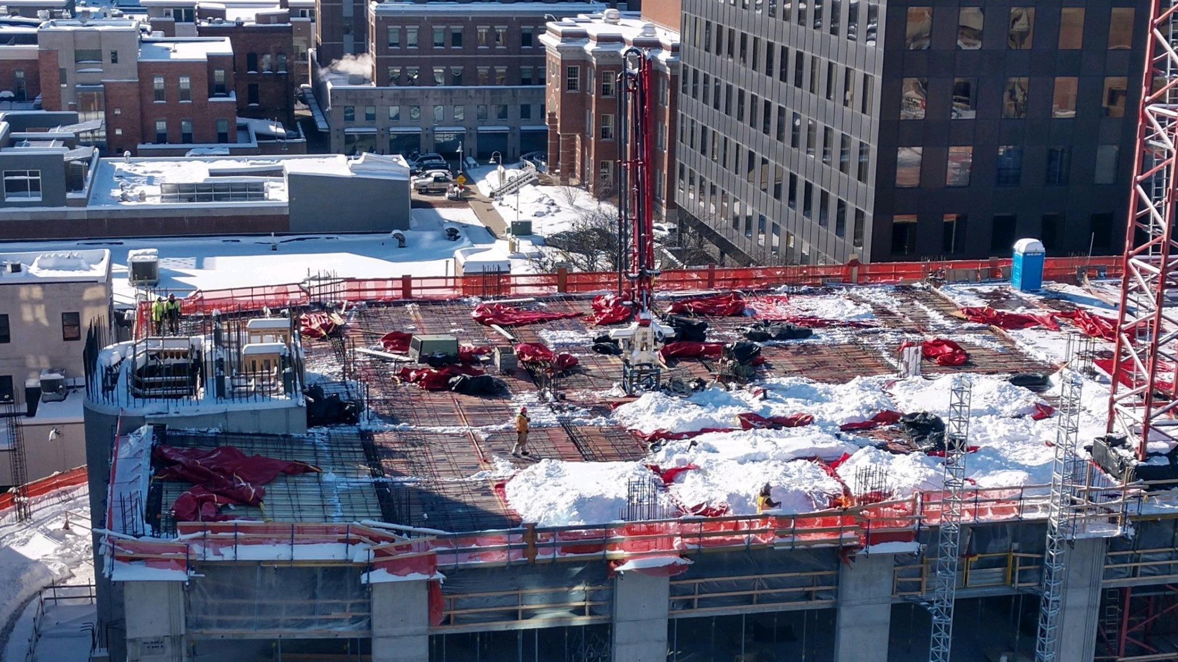
Daily Log: Weather Delays
David Caraccio
Assistant Project Manager
Ancor Inc.

Slide 2
Goals
How to document a weather-related delay
How to run a report for a weather delay

Slide 3
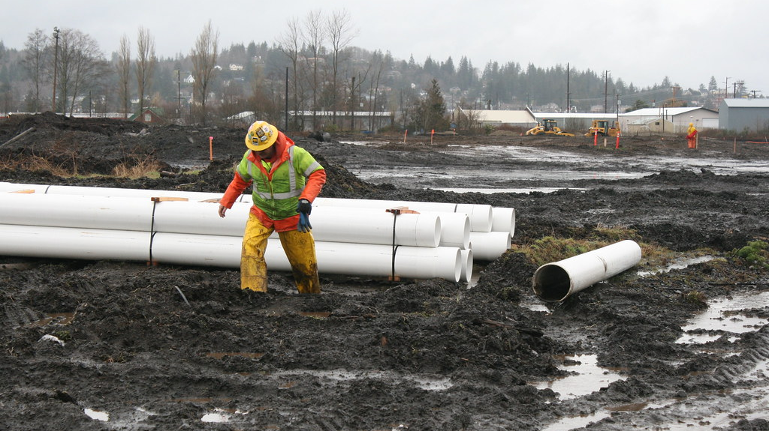
How to document a weather delay.

Slide 4
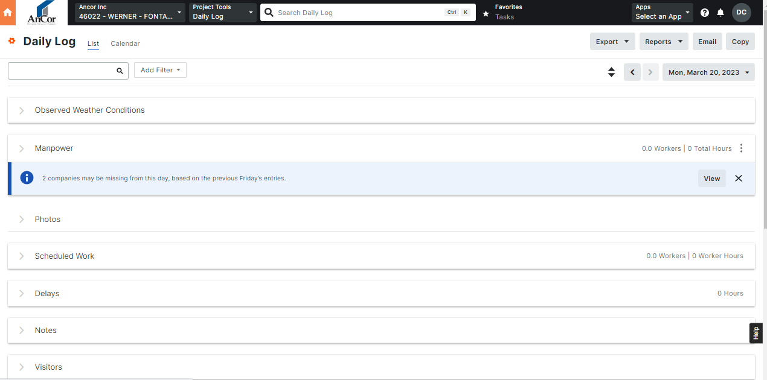
Select Daily Log Tab
Click on drop down Observed Weather Conditions

Slide 5
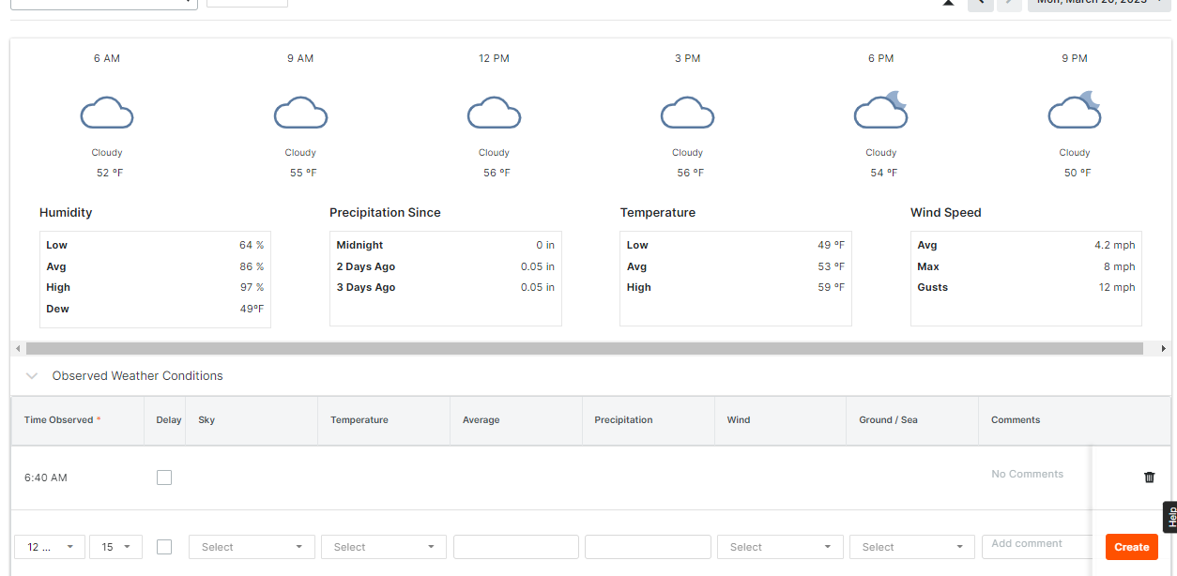
Select Delay
Add any pertinent information regarding weather
Be extremely detailed as to why there was a delay in comments. Include everything that effected production rates.

Slide 6
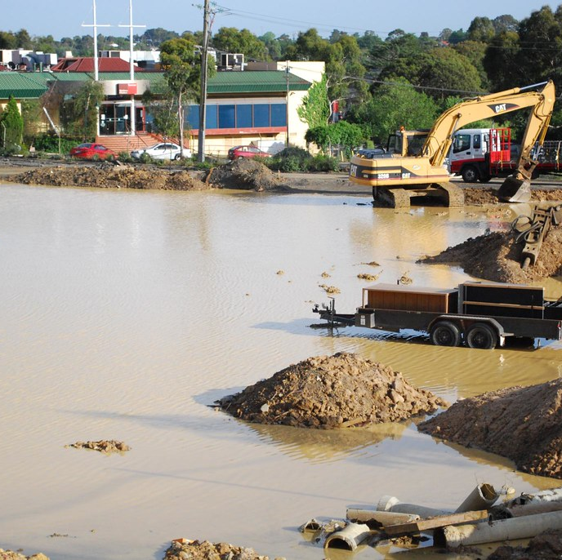
How to run a report for a weather delay

Slide 7
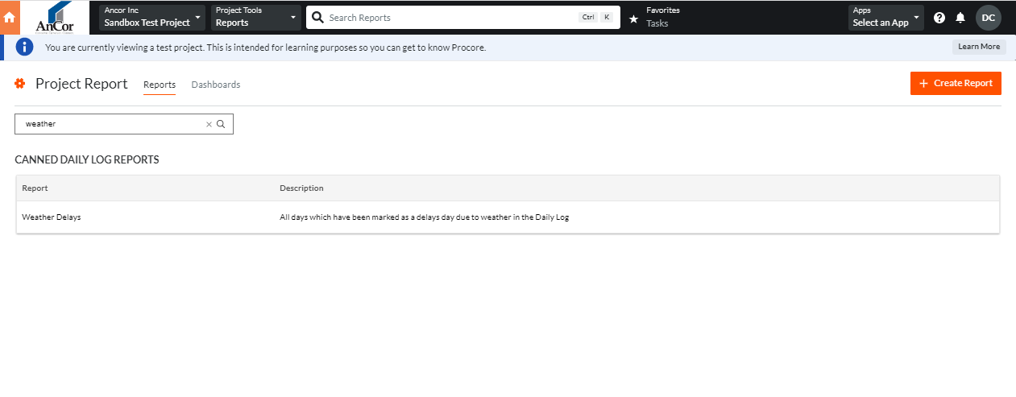
Select Reports Tool
Search for Weather Delays
Select Weather Delays

Slide 8
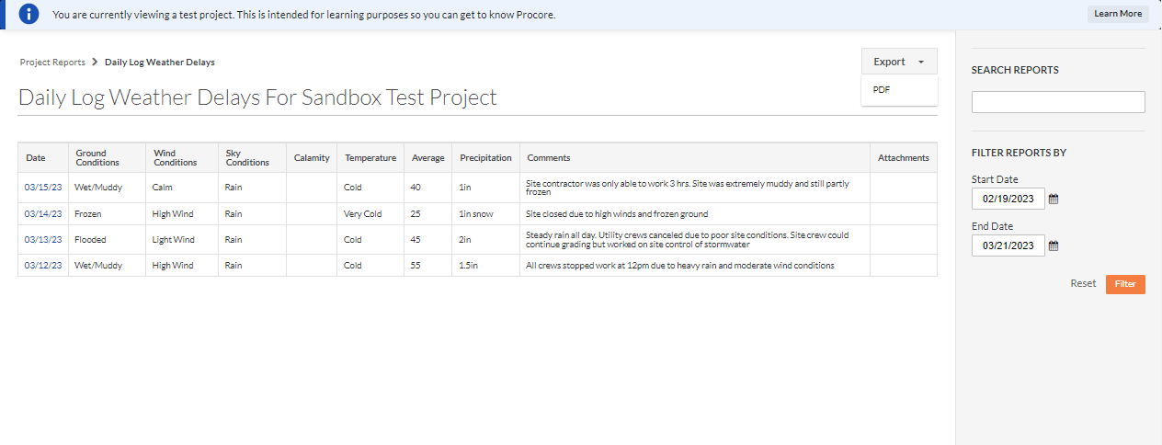
Enter date ranges for report
Select Export
Select PDF

Slide 9
Print/ email report as needed

Slide 10
Key takeaways:
It is critical that weather delay of any time be reported by Supertenants
Reports must be extremely detailed and include
Time of delay
A few hours or all day
Which trades were affected
Include critical path tasks
Weather observed
Time and magnitude spent on damage control

Slide 11
