Slide 1
Project Walk Thru Agenda’s

Slide 2
The Primary Issue in Construction Delivery Today is Communication. The more aligned a team is, the more successful the overall project will be.
Excellent Meetings = Excellent Communication = Excellent Results

Slide 3
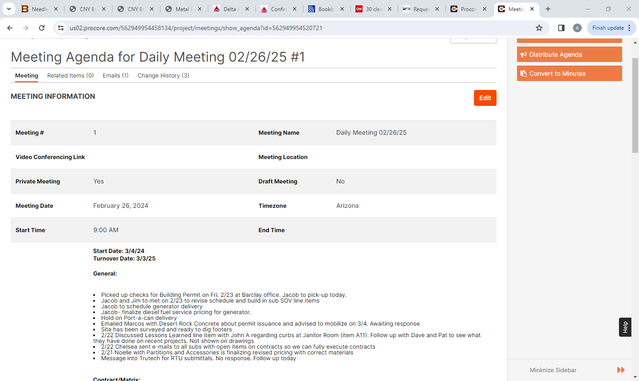
Procore Meeting Tool
Utilizing this tool makes creating agendas, tracking minutes, assigning responsibility and due dates very easy!

Slide 4
3 Types of Walk Thru Agendas
Project Deep Dive - Daily Meeting w AnCor Team
Bi-Weekly Client Walk Thru
Client Visit Walk Thru Form

Slide 5
Daily Meeting w AnCor Team Agenda
Required Attendees – Project Manager, Superintendent, Admin – Op’s/Precon As Needed
Start Date
Turnover Date (if adjusted list ORCA’s)
Super Travel Schedule & PM Site Visit
General Discussion
Review Daily Report
Review HotList
Procore Dashboard
RFI
Submittal
Open Change Orders (Client & Subcontractor)
Building Department Items – Upcoming Inspections/Concerns
Plan Revision Status – Distribution, Schedule and Price Impact
Review Schedule – Procore Master Schedule – Update Percentage Complete and Two Week Lookahead.
Utility Status
Low Voltage/Audio Visual
Client Required Vendors
Specialty Construction Vendors – Client required, pool, owner equipment, elevator etc
Weekly Client Summary Status
Precon
Schedule Review – Overall in Procore & Two Week Lookahead
Utilities
Owner Vendors
Video Job Walk

Slide 6
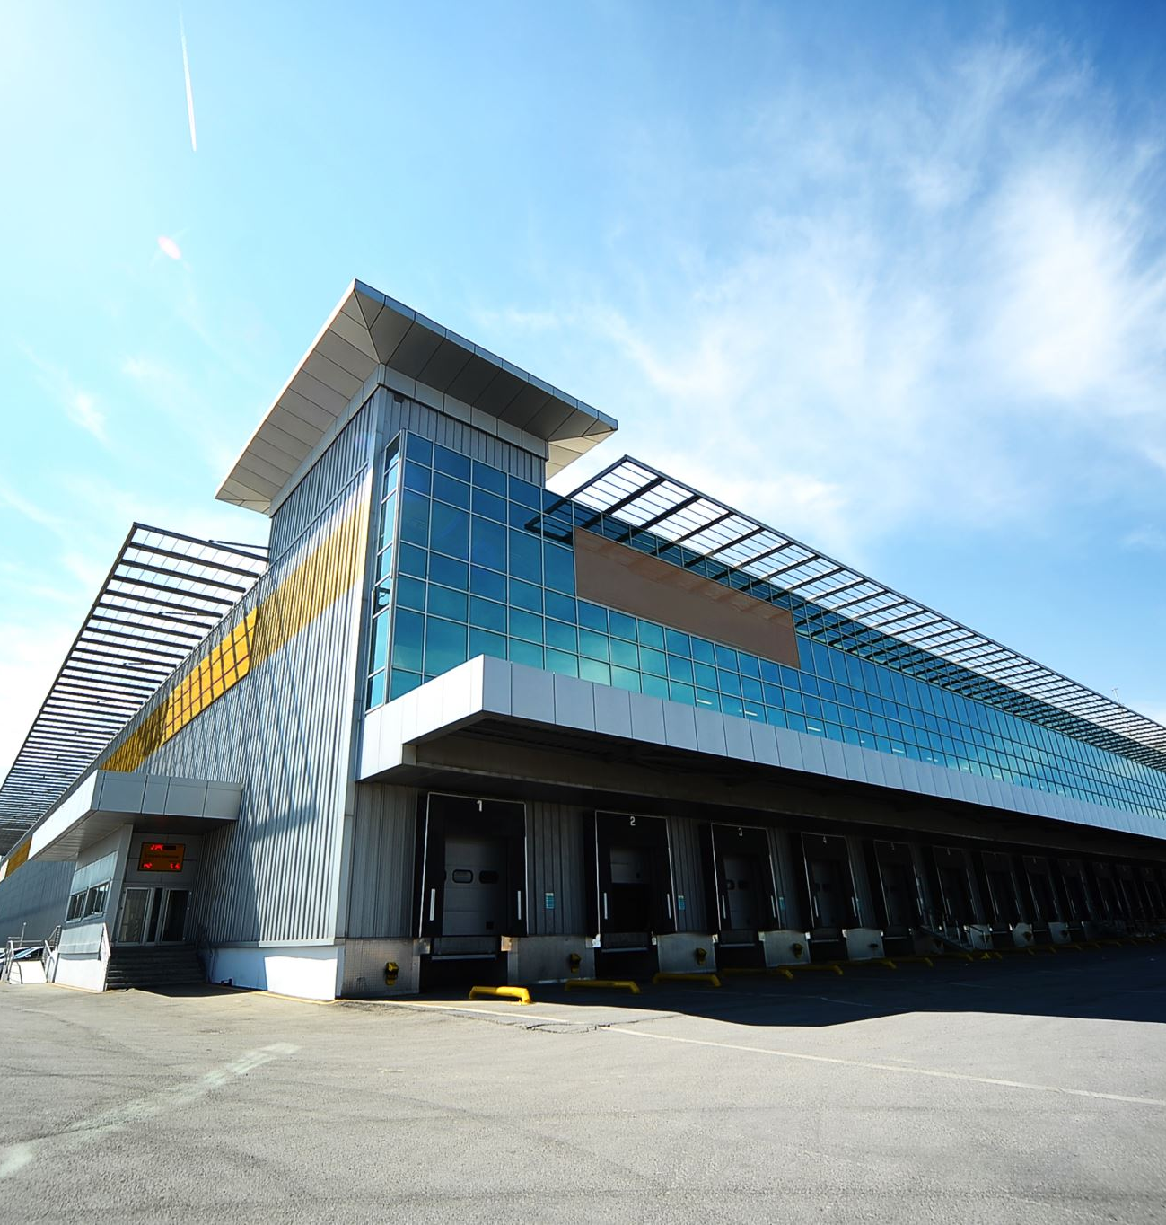
Video Job Walk Requirements
Start at exterior front elevation and walk around site.
When doing interior job walk start at main entrance
Utilize headphones so that your voice is clear
Have subs cease low construction activities prior to meeting
Connect to Hotspot or WiFi
Do a Dry Run to ensure proper connectivity.

Slide 7
Biweekly Client Walk Thru Agenda
General Discussion
Go Through Anything Deemed Important From the daily internal meetings and weekly client summary.
Review Procore Dashboard
RFI’s
Submittals
Open Change Orders
Review Schedule
Commencement Date
Turnover Date
Review Schedule Extension Requirements
Upcoming Two Weeks
Potential Delays
Video Walk Thru (See Slide For Requirements)
Confirm Receipt of Weekly Client Summary

Slide 8
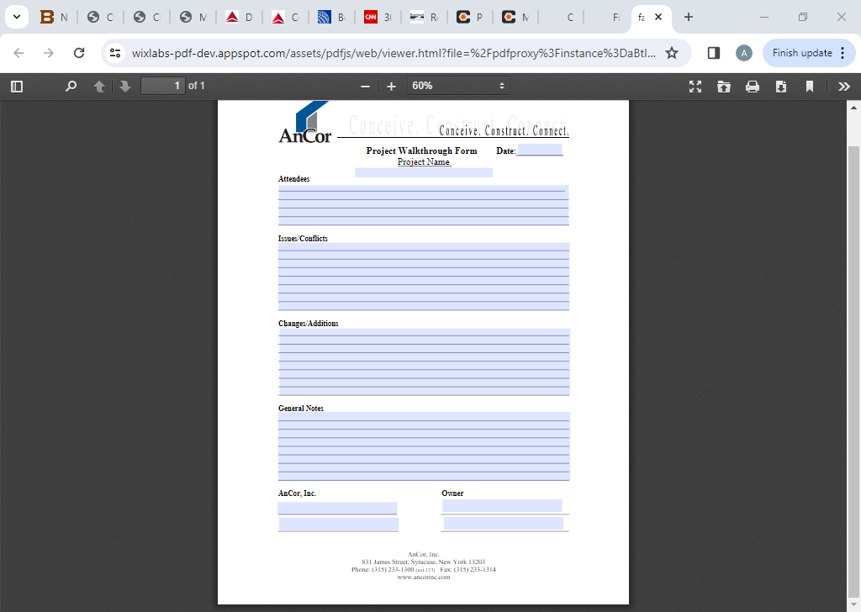
Project Walk Thru Form – Located on AnCorU – Project Mgmt – Fillable Forms – Project Walk Thru Form

Slide 9
Purpose of Project Walkthrough Form
It is critical to document in writing when a client, building inspector, design team member or anyone outside of the day to day project team walks through a site.
Often times these meetings review critical open items or result in changes that need to be documented for further discussion purposes.
This document is to be filled out and then e-mailed to the team members.
This form simply allows our project team to document what was discussed and have the people present sign off. If the people refuse to sign send an e-mail summarizing the meeting and request that any changes be submitted in writing within 48 hours.

Slide 10
Current market conditions in the construction industry consist of labor shortages, long lead times on material delivery, high client expectations and tremendous competition. AnCor must be better than our competition with the level of sophistication we bring to a project in terms of our communication and problem solving abilities. Ensuring we have proper communication with all team members based on regularly occurring meetings with clear agendas will help our delivery process ensuring better client satisfaction.

