Slide 1

Plan Reading for
Project Superintendent
Reading Architectural Plumbing, Mechanical, Electrical and Civil Drawings

Slide 2
Overview
This presentation will cover some of the basics of reading architectural, mechanical, plumbing, electrical and civil drawings.
This training is intended to help you find information, understand symbols and answer questions that come up every day on the job site.
The project drawings and specification are part of, and often referred to as, part of the “Contract Document”.

Slide 3
Contract Documents consist of the following
The agreement with the owner and the contractor
The supplemental General Conditions
Subcontracts
Insurance Certificates
The Drawings and Specifications
RFIs Prior to the award
RFIs after the award
Shop drawing and submittals
As built drawings
For this session we’ll cover the drawings and specification

Slide 4
Contract Documents Hierarchy
Certain documents can override other documents.
For Instance:
Approved Shop Drawings and submittals override the project drawings and specification.
The larger scale drawing or details will always take presidency over smaller scale drawings
As an Example
Rebar shop drawings are used to place and inspect the rebar.
Erection drawings are used to erect the structural steel
Cut sheets of equipment or millwork should always be considered when checking dimensions

Slide 5
Shop drawings and submittals
Depending on the project and the requirements outlined in the specification submittals may or may not be required.
On some projects submittal review by the architect or engineer is not included in their agreement with the owner.
On some projects the owner will review submittals.
Regardless of who reviews or approves a submittal the submittal does not alleviate the contractor of meeting the requirements or intent of the contract drawings and specifications. Read the disclaimer stamp on the next slide carefully.
You always have to reference both the submittal and the drawings and specifications.

Slide 6
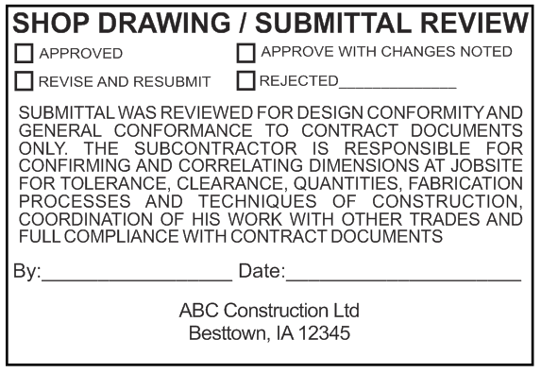
Sample submittal disclaimer stamp

Slide 7
This is the contract drawing for a pilot truck care service pit

Slide 8
This is a typical rebar shop drawing for a Pilot Truck Care.
Note the details and dimensions are more defined on the shop drawing
But some dimension need to come from the contract drawings as well

Slide 9
Catalog cut sheets
Catalog cut sheets can be an immeasurable help when doing any project that requires the installation of equipment. Restaurants especially.
In the time it took for the design professional to design the facility to when construction starts a piece of equipment could have changes ever so slightly as to make it not fit correctly.
A shop drawing or cut sheet for a manufactured piece of equipment made for a specific job is a must to have on site and regardless of all else it must take presidency.
You should have the shop drawing before the space is constructed and you need to verify that it will indeed fit as the designer intended. This is your only chance to prevent a costly delay.
If it doesn’t fit stop and contact the project manager or the designer

Slide 10
The internet
Perhaps the best source for information on any subject, product or piece of equipment is the internet.
Simply google a product by name or by model number and just about anything you need to know is at your fingertips.
In many cases a Utube video is available to show exactly how the product is used, installed or applied.
Take the time to look up equipment or materials and become familiar with the installation and how it works.
Download and print the cut sheet. It will come in handy.

Slide 11
https://www.utcccs-cdn.com/hvac/docs/1005/Public/04/48HC-17-28-03PD.pdf
This web address will take you to the installation instructions for a Carrier Weather Master Roof Top Unit (RTU)
The information on this site will tell you everything you need to know about this unit and describes in full the installation process.
  Size
  Weight
  How to pick it up
  Duct connections
  Roof penetrations
  Controls wiring
  Power wiring
Even though your HVAC contractor knows how to install it there is information you need as well in these instruction.
You can do this for just about any piece of equipment or product

Slide 12
Reading the drawings

Slide 13
Important Information on Every Drawing
Title Block
  Sheet Number & Project Number
  Project Name
  Drawing Date
  Revision Number and Date
  Architectural or Engineering Firm

Slide 14
The Title Block
Information in the title block will help you to:
Formulate RFI questions by referencing drawing numbers, revision dates and who to address questions to.
Check the title block to make sure that all subs are using the most current drawings

Slide 15
Revisions
Always check the title block for revisions.
However architects and engineers don’t always put in a revision number or date. So just because you don’t see a revision listed in the title block does not mean the drawing hasn’t been revised.
As you can imagine this can cause all sorts of issues.
If a revised drawing comes into the office the project manager should check for a revision date and number. If there isn’t a revision number or revision date the PM can use the date the drawing was received to log in the revision. The PM should also contact the issuer of the drawing and ask them to update the title block.
The project manager will issue the revision to the project team.
It is the superintendents responsibility to make sure everyone is using the latest drawing.

Slide 16
Revisions should also be clouded.
The revision should have a cloud drawn around the revision and the revision number should be noted along side of the cloud.

Slide 17
General Notes
General notes are typically one of the first pages in the drawing set. The notes cover
  Governing Codes
  Standards used in the design
  Various information outlining responsibilities of the contractor
  Abbreviations
Be sure to read all the general notes and all the notes on every page of the drawing set.
When answering a question for a subcontractor may times the answer is in the notes.

Slide 18
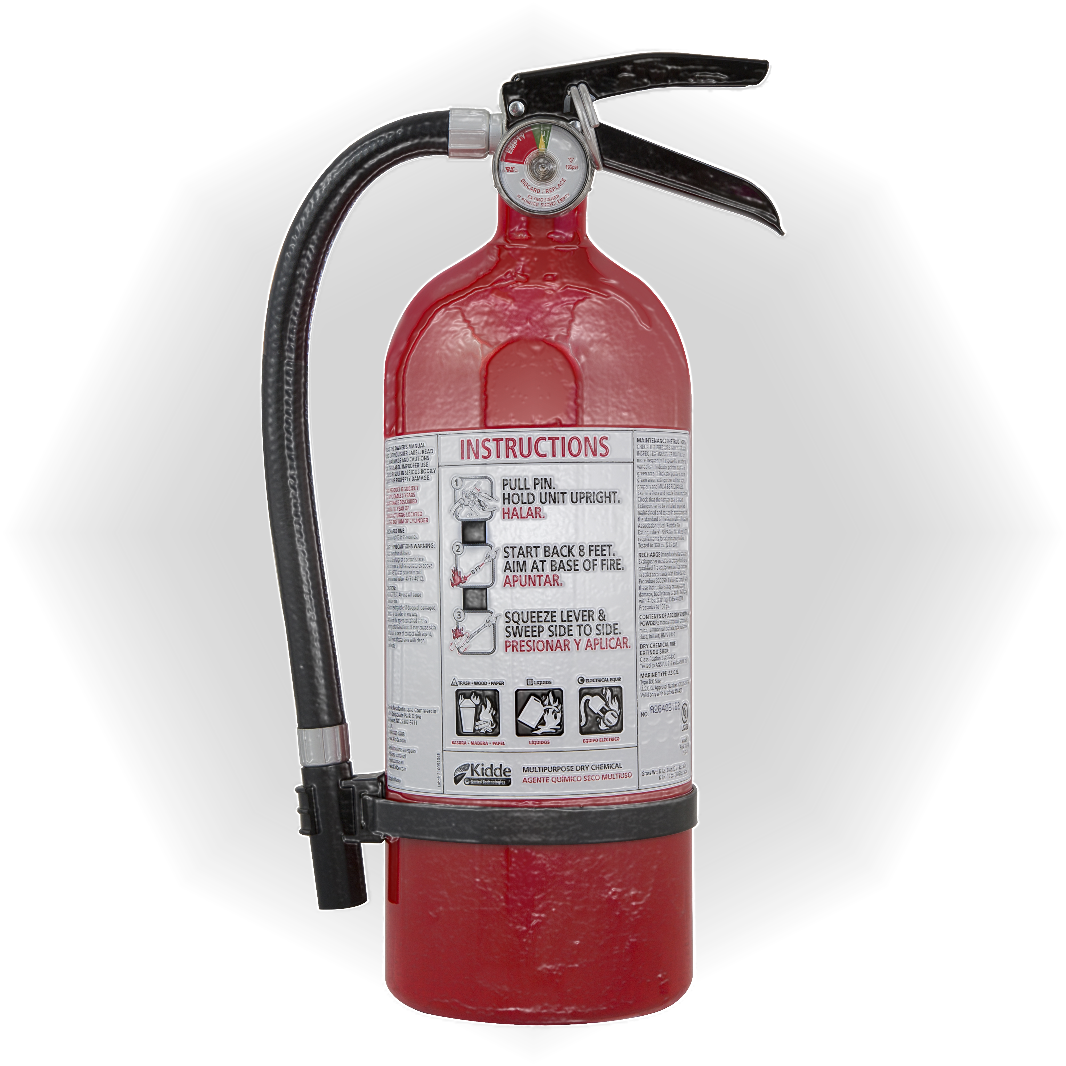
Occupancy Plan
The occupancy plan is typically important only to the municipality.
It tells how far it is to an exit at any given point in the building
It tells where fire extinguishers go and how many will be needed.
The occupancy plan give a preliminary fire alarm layout
It may tell the square footage of each room or space
The plan could talks about fire ratings or specific code issues

Slide 19
ADA Standards
ADA Standards are usually one of the first few drawings in the set.
It’s very important to be sure that the standards are always met. An inspector may not issue a C of O if the site is not ADA compliant
It’s a safe bet the drawings are correct however slight mismeasurements or misinterpretation can be disastrous.
A complete ADA guide is available on line at:
https://www.ada.gov/regs2010/2010ADAStandards/2010ADAStandards.pdf

Slide 22
The Architectural Drawings
A-1, A-01, A100 are always the floor plan
A-1.1, 1.2, 1.3 etc. are usually notes or details related to A-1
A-2, A-02, A-200 are usually a finish plan
A-3, A-03, A-300 are usually Reflected Ceiling Plans
A-4, A-04, A-400 are typically roof plans
A-5, can be details, equipment or millwork
A-6 is typically the exterior elevation
The rest are typically details or schedules.

Slide 23
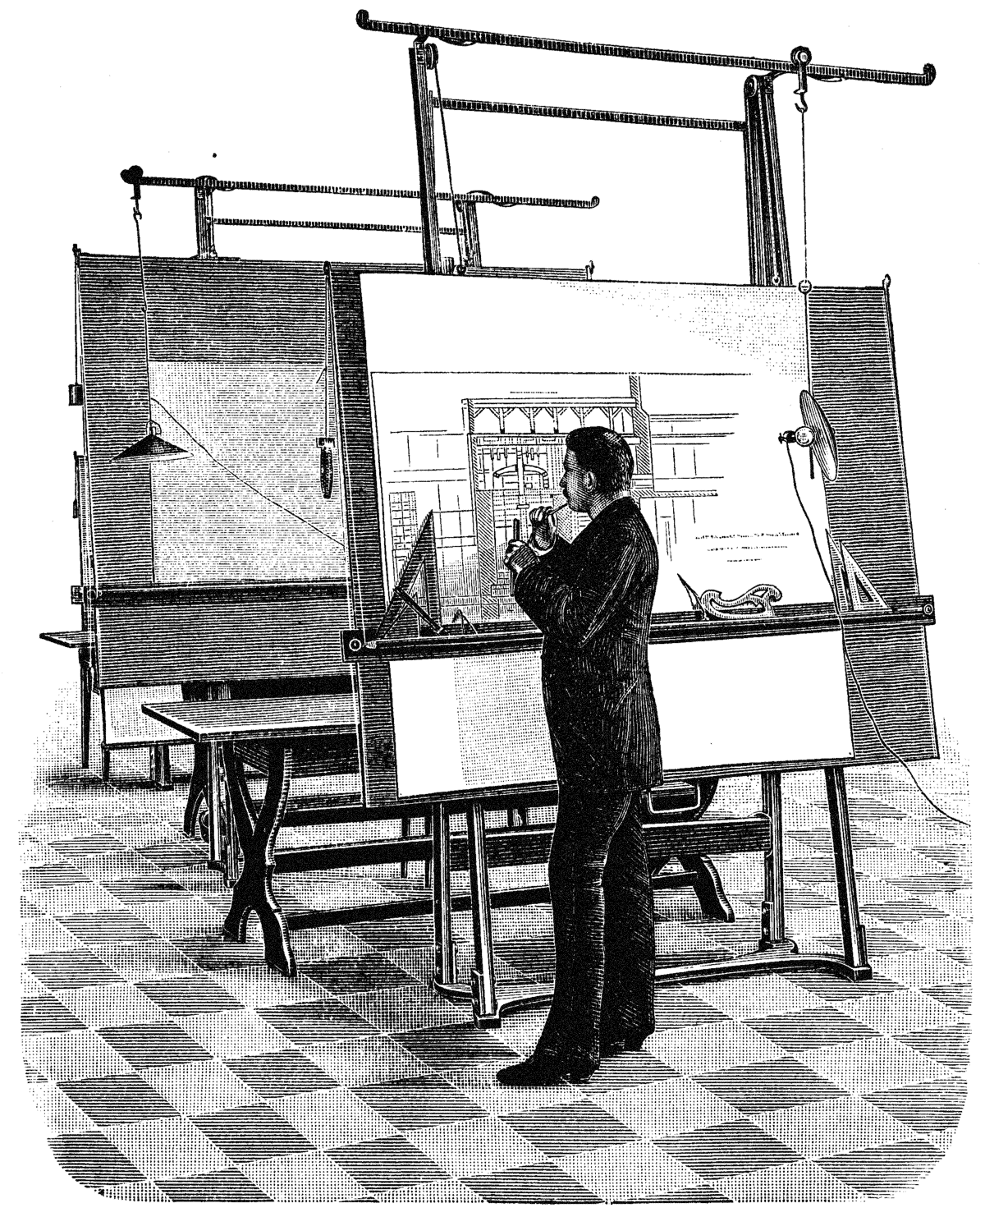
Before computers architectural drawings were done by hand. Measuring was done with a scale and only the information relevant to the task was on the drawing.
Today most architectural and engineering drawings as well as shop drawings are done in CAD or REVIT.
CAD produces the more common 2D drawings we build from
REVIT can produce the same 2D drawings as CAD however it can also produce a BIM file (Building Information Modeling)
BIM is used by architects, engineers and contractors to produce a collaborative 3D model of the project showing all it’s components and the interaction between them.
The idea is to discover and correct possible conflicts and obstructions in the design phase rather that the actual construction phase of the project.

Slide 24
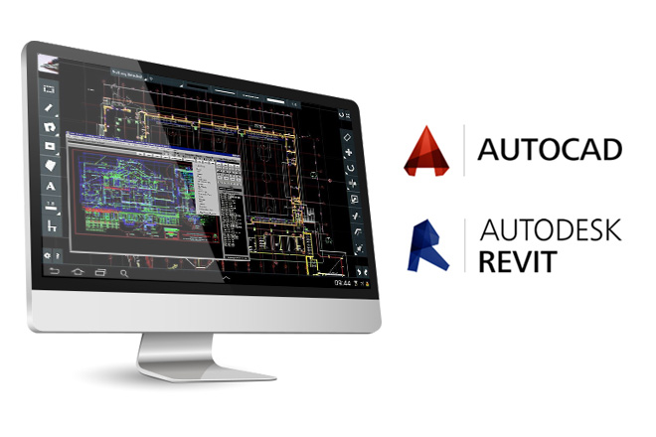
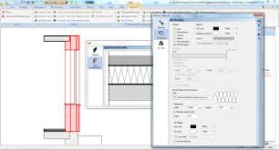
When working with CAD the operator sees only a small portion of the project at one time.
Because of the large scale they see they can insert a lot of information that sometimes is not quite as clear when the drawing is printed at actual scale.

Slide 25
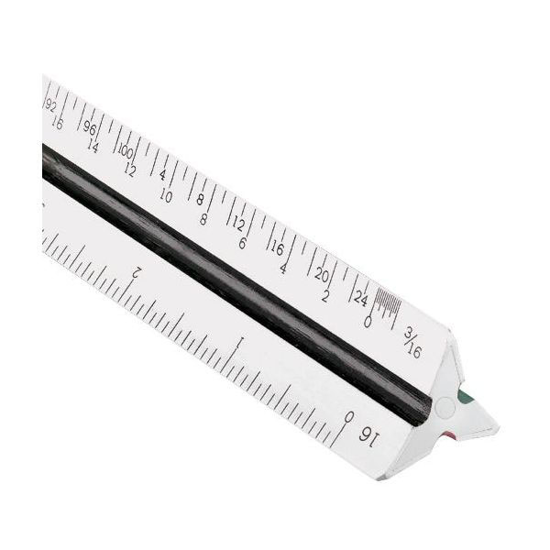
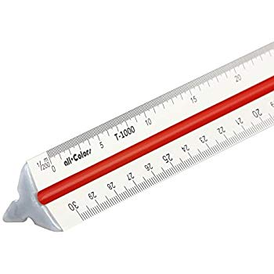
Measuring & Scale
Architects Scale
Engineers Scale
Somewhere on each drawing or each detail there should be the scale that the drawing was drawn to.
¼” = 1’-0”
You should never scale a drawing dimension
If the drawings were not printed to full scale then the scale will be off.

Slide 26
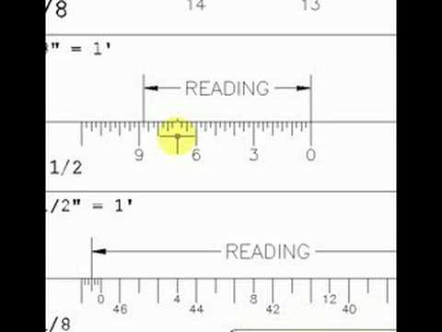
An Architects Scale is drawn is in feet and inches.
¼” = 1’-0”
1 ½ “ =1’-0”
¾ “ = 1’-0”
And so on.
At the end of the scale the foot dimension is broken down into inches.
Scaling a drawing is dangerous and should not be done.
Reproduction of an original drawing can affect the scale.

Slide 27
An Engineers scale is used for site work or
Civil drawings and is graduated in 10ths of
A foot.
Civil drawings are always drawn in both 10ths and inches.
Elevations are typically in feet and 10ths.
Dimensions are typically in feet and inches
The conversion to inches is not always exact but a good construction calculator can covert 10ths to inches accurately.
On your phone download the construction master calculator.

Slide 28
Abbreviations
http://academics.triton.edu/faculty/fheitzman/abbrev.html

Slide 29
A/C AIR CONDITIONING
ACC ACCESSIBILITY
ACT ACOUSTIC CEILING TILE
AFC ABOVE FINISH CEILING
AFF ABOVE FINISH FLOOR
ALUM ALUMINUM
APPROX APPROXIMATELY
BD BOARD
BLDG BUILDING
BLK BLOCK
B/ BOTTOM OF
CC CONCRETE CONTRACTOR
CL CENTER LINE
CLG CEILING
CMU CONCRETE MASONRY UNIT
CO CLEAN OUT
COL COLUMN
CONC CONCRETE
CONT CONTINUOUS
CT CERAMIC TILE
DEMO DEMOLITION
DET DETAIL
DIA, Ø DIAMETER
DIM DIMENSION
DWG DRAWING

Slide 30
CC CONCRETE CONTRACTOR
CL CENTER LINE
CLG CEILING
CMU CONCRETE MASONRY UNIT
CO CLEAN OUT
COL COLUMN
CONC CONCRETE
CONT CONTINUOUS
CT CERAMIC TILE
DEMO DEMOLITION
DET DETAIL
DIA, Ø DIAMETER
DIM DIMENSION
DWG DRAWING
EA EACH
EC ELECTRICAL CONTRACTOR
EIFS EXTERIOR INSULATION
FINISH SYSTEM
ELEC ELECTRICAL
ELEV ELEVATION
EQ EQUAL
EQUIP EQUIPMENT
EU ELECTRIC UTILITY
EX'G EXISTING
EXT EXTERIOR
FA FIRE ALARM CONTRACTOR
FC FINISH CARPENTRY
CONTRACTOR
FD FLOOR DRAIN
FIN FINISH
FIXT FIXTURE
FR FIRE RISER
FRC FRAMING CONTRACTOR
FRP FIBERGLASS REINFORCED PANEL
FS FLOOR SINK
FSC FIRE SUPPRESSION
CONTRACTOR
FT FOOT

Slide 31
Ga GAUGE
GALV GALVANIZED
GC GENERAL CONTRACTOR
GLAZ GLAZING
GWB GYPSUM WALL BOARD
GYP GYPSUM
HB HOSE BIB
HC HOLLOW CORE
HM HOLLOW METAL
HGT HEIGHT
HORIZ HORIZONTAL
HVAC HEATING VENTILATION
& AIR CONDITIONING
HVC HVAC CONTRACTOR
HW HOT WATER
IN INCH
INSUL INSULATION
INT INTERIOR
JST JOIST
LAM LAMINATE
LAV LAVATORY
LL LANDLORD
MAT MATERIAL
MAX MAXIMUM
MECH MECHANICAL
MIN MINIMUM
MISC MISCELLANEOUS
MTL METAL

Slide 32
N/A NOT APPLICABLE
No. # NUMBER
NTS NOT TO SCALE
OA OVERALL
OC ON CENTER
PC PLUMBING CONTRACTOR
PH PHONE COMPANY
PL PROPERTY LINE
PLAM PLASTIC LAMINATE
PLAS PLASTIC
PLUMB PLUMBING
PLYWD PLYWOOD
PVC POLYVINYL CHLORIDE
POS POINT OF SALE TERMINAL
P.O.B. POINT OF BEGINNING
PREP PREPARE/ PREPARATION
PT PAINT
PTC PAINT CO
QT QUARRY TILE
RA RETURN AIR
RAD RADIUS
RC ROOFING CONTRACTOR
REG REGULAR
REINF REINFORCED
REQ'D REQUIRED
REV REVERSED OR REVISION
RL ROOF LEADER
RM ROOM
RO ROUGH OPENING
ROW RIGHT OF WAY
SA SUPPLY AIR
SC SOLID CORE
SCHED SCHEDULE
SG SIGN CONTRACTOR
SIM SIMILAR

Slide 33
SL SPECIALTY LIGHTING
SPC SPRINKLER CONTRACTOR
SPEC'D SPECIFIED
SPEC SPECIFICATION
SQ SQUARE
SF SQUARE FOOT
SS STAINLESS STEEL
STRUCT STRUCTURAL
STL STEEL
SUSP SUSPENDED
T/ TOP OF
TEL TELEPHONE
THK THICKNESS
TYP TYPICAL
UL UNDERWRITER'S LABORATORY
UNO UNLESS NOTED OTHERWISE
VCT VINYL COMPOSITION TILE
VERT VERTICAL
VIF VERIFY IN FIELD
W WASSERSTROM
W/ WITH
WC WATER CLOSET
WD WOOD
WL WATER LINE
W/O WITHOUT
ZEE OWNER / FRANCHISEE

Slide 34
Dimensions

Slide 35
What are some of the line and dimensions in this drawing telling us.
It’s very hard to tell sometimes.
The circled numbers are typically column lines or center of column and are one of the most important dimension line on the drawing.
However on this drawing line 1 and 4 happen to be edge of slab.
Column Line are consistent from one drawing to the next.
Dimensions off of column lines (CL) are easy to define and are typically from center of column
Column lines carry through to all structural and MEP drawings.
When ever possible use dimensions referenced from column lines.
Be sure to read the notes on every drawing to determine where dimensions are to:
Center of wall
Face of stud
Face of finish wall

Slide 36
Read the Notes

Slide 37
Dimensioning on a drawing should always be from the same starting point. For instance from the back or side wall, from a column line or the edge of a slab.
Dimensioning should always go in one direction.
You should be able to add up a string of dimensions in one direction and layout every feature exactly as it’s shown on the drawings.
If some dimensions are taken from the rear wall and some from the front wall it’s almost a certainty that they will not meet in the middle. It may only be off a fraction of an inch however in some situation a fraction can mean disaster.
  A piece if equipment requires 37 ¾”. If the space is off even a ¼” the equipment won’t fit.

Slide 38
Typically a number in a circle indicates center of column.
In this drawing however it’s easy to see that it is not in line with the column but in stead it’s indicating the edge of the floor slab.
But what’s the other line to the outside?
Is the circled 4 in line with the inside line or the outside line?
In this case the outside line is the building siding and is totally irrelevant.
This project is a Pilot Truck Care so the Butler erection drawings also need to be considered.

Slide 39
The outside line is not relevant for laying out the building and actually causes more confusion.
In this case the distance between the two lines is about 4 ½” or 9” in the overall width of the building.
The columns and partitions are dimensioned off the edge of the slab so it’s not hard to see that if dimensions were taken off the wrong line there would be major problems .

Slide 40
The other thing to note in this example is that the 9’-4” dimension is not to the wall for door 102A but to the edge of the B1 wall.
There is a lot of information and lines on this drawing that are not necessarily needed and in fact can cause confusion.
Lines 1, 4 and G are edge of slab.
Lines 2, 3 and F are center of column
To layout the bathrooms you need to find the CMU wall D, find the dimension of the sales counter in the details or from the shop drawings and go to the 1 on A9 to get the dimension of the restroom.

Slide 41
WALL TYPES AND SCHEDULES
Wall types and schedules can be presented is a number of ways.
Some architects will draw a section of the wall and label it A, B, B1 C and so on.

Slide 42
Another method is a Wall Tag

Slide 43
Structural Drawings and Wall Types
In some cases you’ll need to refer to the structural drawings for further details or identification of materials like stud size and type of drywall.
The structural drawings will override the architectural drawings when it comes to specification of materials.
For instance:
On the architectural drawings it may say that the gage of all metal framing is 20 gage unless otherwise noted.
Always check the structural drawings for “otherwise noted”
Also check the specifications and if there is one the land loard work letter.
Studs over a certain height might need to be heavier than 20 gage.

Slide 44
On the structural Drawings you might see the following note in some form.

Slide 45
Cold form framing designation

Slide 46
Structural metal framing is identified differently than non-structural framing. It is usually referred to as CFS framing. (Cold Form Steel)
Cold form means it is made on a brake from sheet metal. Structural steel is extruded in a steel mill.
You will see a string of numbers such as
600S162-43
  600 = 6 inch studs
  162 = 1 5/8 return leg
  43 = the gage of the studs
If you simply google the number 600162-43 it will take you to web sites that will explain what the number represent
Clark Dietrich is the best site to go to.
https://www.clarkdietrich.com/sites/default/files/imce/pdf/SupportDocs/ProductInfo/CD_Product_Identification.pdf

Slide 48
The structural drawings will give you details and information that is not on the architectural drawings but remember the structural drawings rule.
Other information on the structural drawings might be:
Screw size, type and spacing
Type of drywall
  Fire Code
  Rough Service
  Moisture Resistant
  Cement Board
  Fiberglass reinforced or Densglass
Special Connectors
Lintel components or makeup
Spacing of structural members
What type of top track to use
  Deflection or slotted
  Deep track
It might tell you not to fasten the studs or drywall to the top track
The screw pattern for the drywall

Slide 49
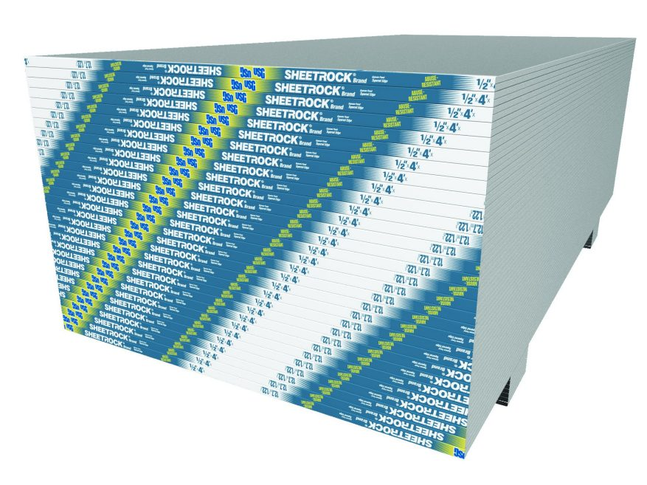
Go to USG’s web site at the address below and explore the different types of drywall and there uses .
USG also has information on framing systems and ceilings
It’s always a good idea to become familiar with the products you’ll be using.
https://www.usg.com/content/usgcom/en/products/walls/drywall.html

Slide 50
SCHEDULES

Slide 51
Door schedules
Door Schedules tell us the following information
Door Number
Door Material
Door Type
Fire Rating
Size
Frame Type
Frame Material
Hardware
Special Notes

Slide 52
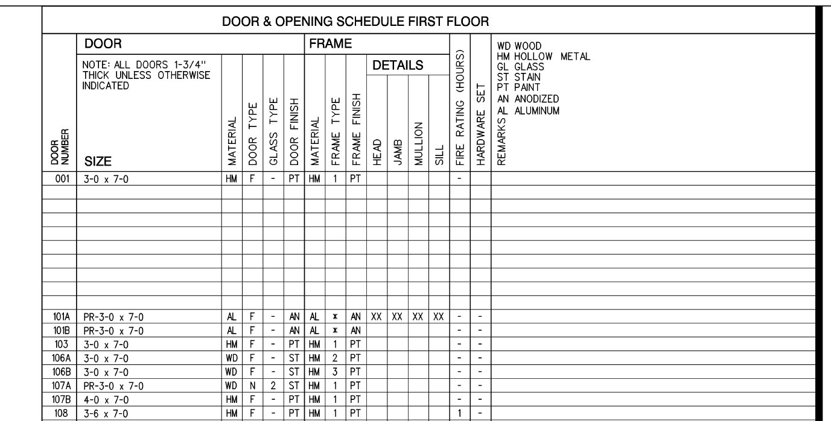
A Simple Door Schedule

Slide 53
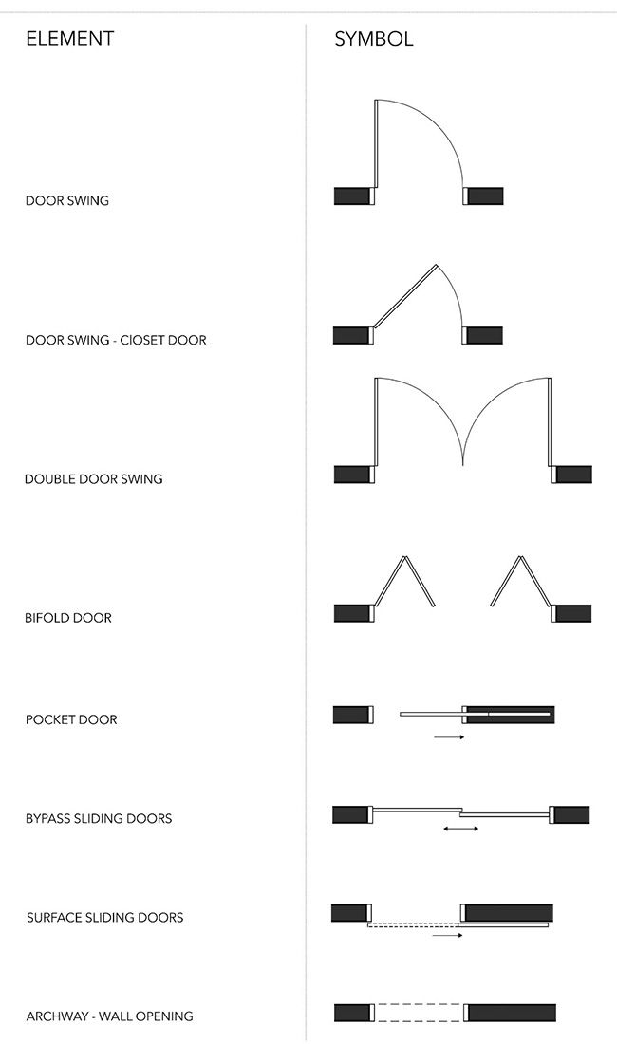
Door Basics
Door sizes are usually written in the opening as a number.
The first 2 numbers are the width and the second 2 number are the height.
  3068 = 3’-0” wide X 6’-8” Tall
  2670 = 2’-6” wide X 7’-0” Tall
A double door would be
  6070 = a pair of 3’-0” X 7’-0” doors
Doors are referred to as leaf’s
Most doors are:
  Wood, Hollow Core or Solid Core
  Hollow Metal
  Aluminum
  Glass
  Fiberglass
Doors are sometimes called out to be fire rated.
  45 minute
  1 hour
  2 hour
  3 hour
The rating is the time it takes for fire to burn through the door.
Glass in a door is referred to as a “Lite”
A glass panel next to a door is a “side lite”
Glass panels over a door is called a “transom”

Slide 54
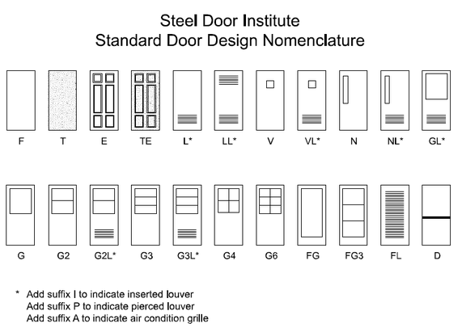
There are thousands of door types and configurations.
These are just a few of the hollow metal doors

Slide 55
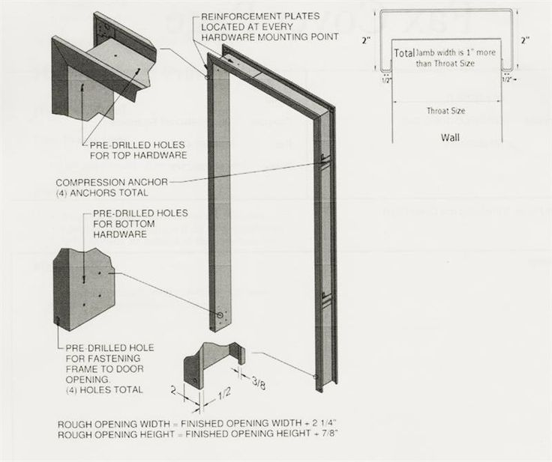
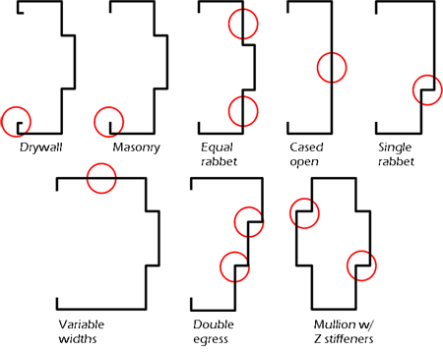
Hollow Metal Frame Shapes

Slide 56
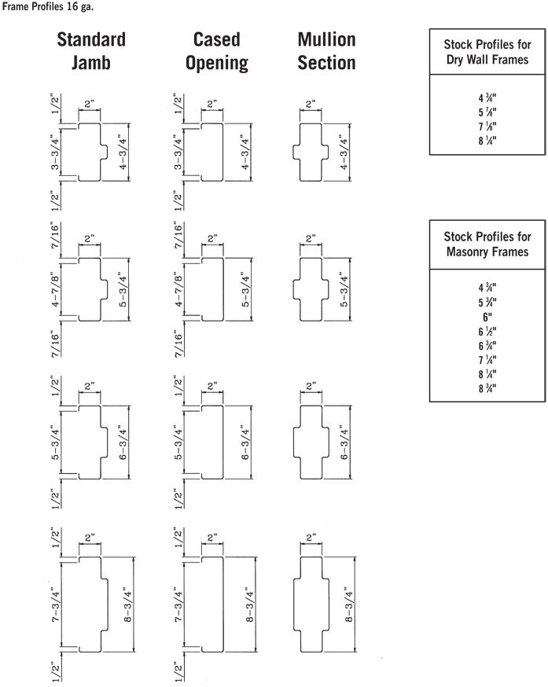
Door frames come in standard sizes according to wall thickness.
A 3 ½” metal stud with 5/8 GWB on each side is 4 ¾” thick. The wall thickness relates to the throat size of the frame or the clear distance between the returns.
For this wall thickness we would order a 4 7/8 throat which leaves a 1/16” on each side.
A 6 “ stud with 5/8 GWB on each side would be 7 ¼

Slide 57
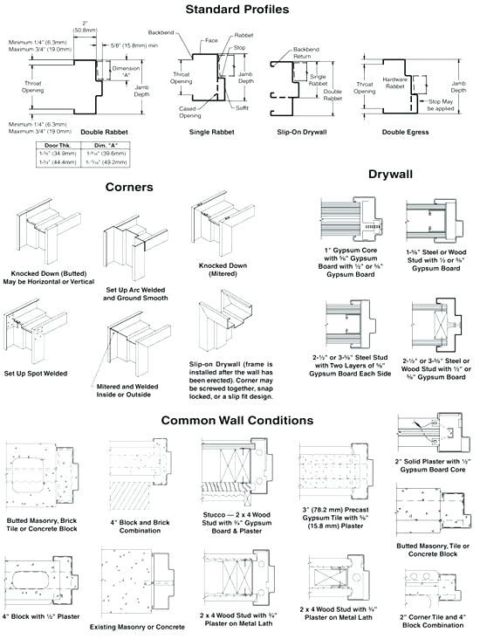
Doors frames can be shipped either “KD” knock down or Welded
A door going in a masonry opening needs to have a 4” header.
Masonry coursing is in 8” increments.
11 8” courses = 88”
An 84” (7’) door plus 4” = 88”

Slide 58
On a drawing you may see RO or MO next to the dimension for a door or window opening.
RO = ROUGH OPENING
MO= MASONRY OPENING
The RO is the dimension that the opening needs to be to fit the frame and is typically 2” larger than the door. A 3070 door in wood or metal framing would have an RO of 3’-2” X 7’-1”.
A welded frame being installed in a framed wall needs to be installed when the framing is being done. A KD frame can be installed after the sheetrock.
The MO is the width of the door plus 4 inches or the width of the overall frame and plus 4 inches at the header.
The MO for a 3070 door would be 3’-4” X 7’-4”

Slide 59
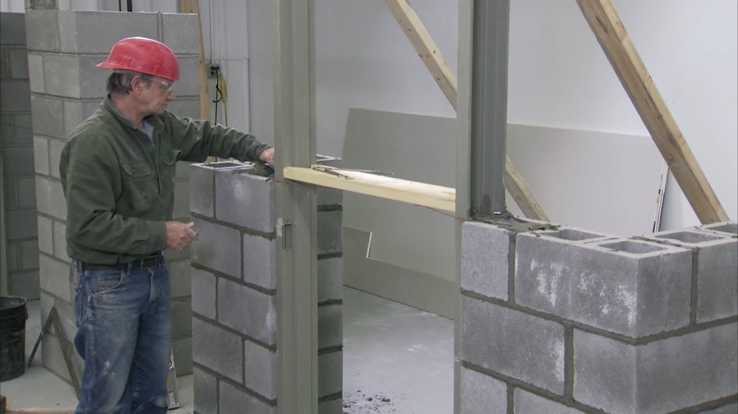
When installing a hollow metal frame in a masonry wall be sure that the frame is plumb, level and square.
Be sure the mason installs spreaders at the bottom and at in the middle of the frame.
Take your 4 foot level and check the frames several times during the installation.
Once the wall is done it’s too late to make corrections or adjustments.

Slide 60
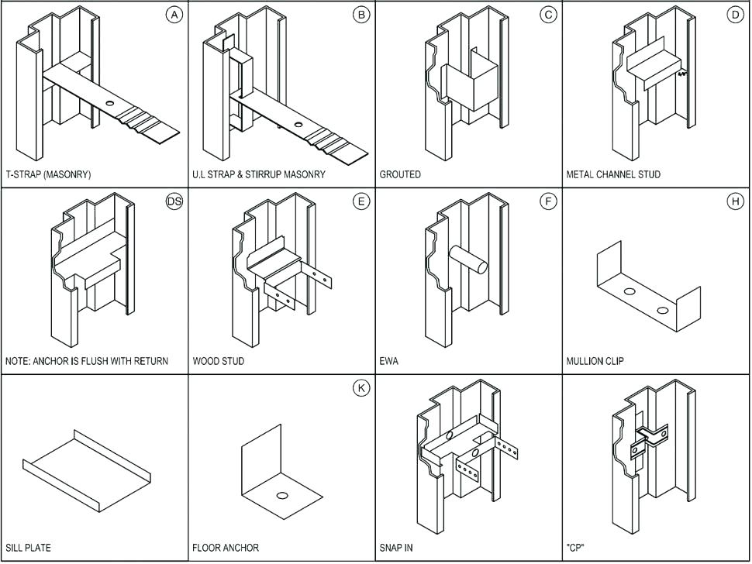
Hollow Metal Door Frames Anchoring Options

Slide 61
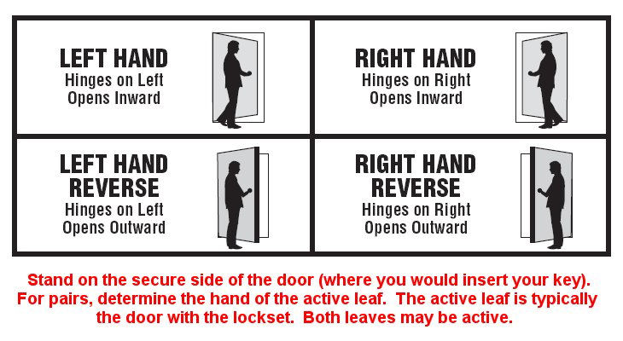
Door handing:
Doors are Right Hand, Left Hand, Right Hand Revers and Left Hand Reverse.
The revers designation typically refers to exterior doors
To determine the handing of an interior door stand with your back to the hinge side of the Jamb. Swing your right or left arm in the direction of the door swing. If your right arm represents door swing it’s a right hand door if your left arm is the door swing it’s a left hand door.

Slide 62
Hardware Schedules
Door Hardware is typically scheduled by Groups or Sets.
On the door Schedule there will be an entry for hardware groupe or set.
Refer to the specifications under Division 8 for Door Hardware.
https://productmasterspec.com/door_specifications/3

Slide 63
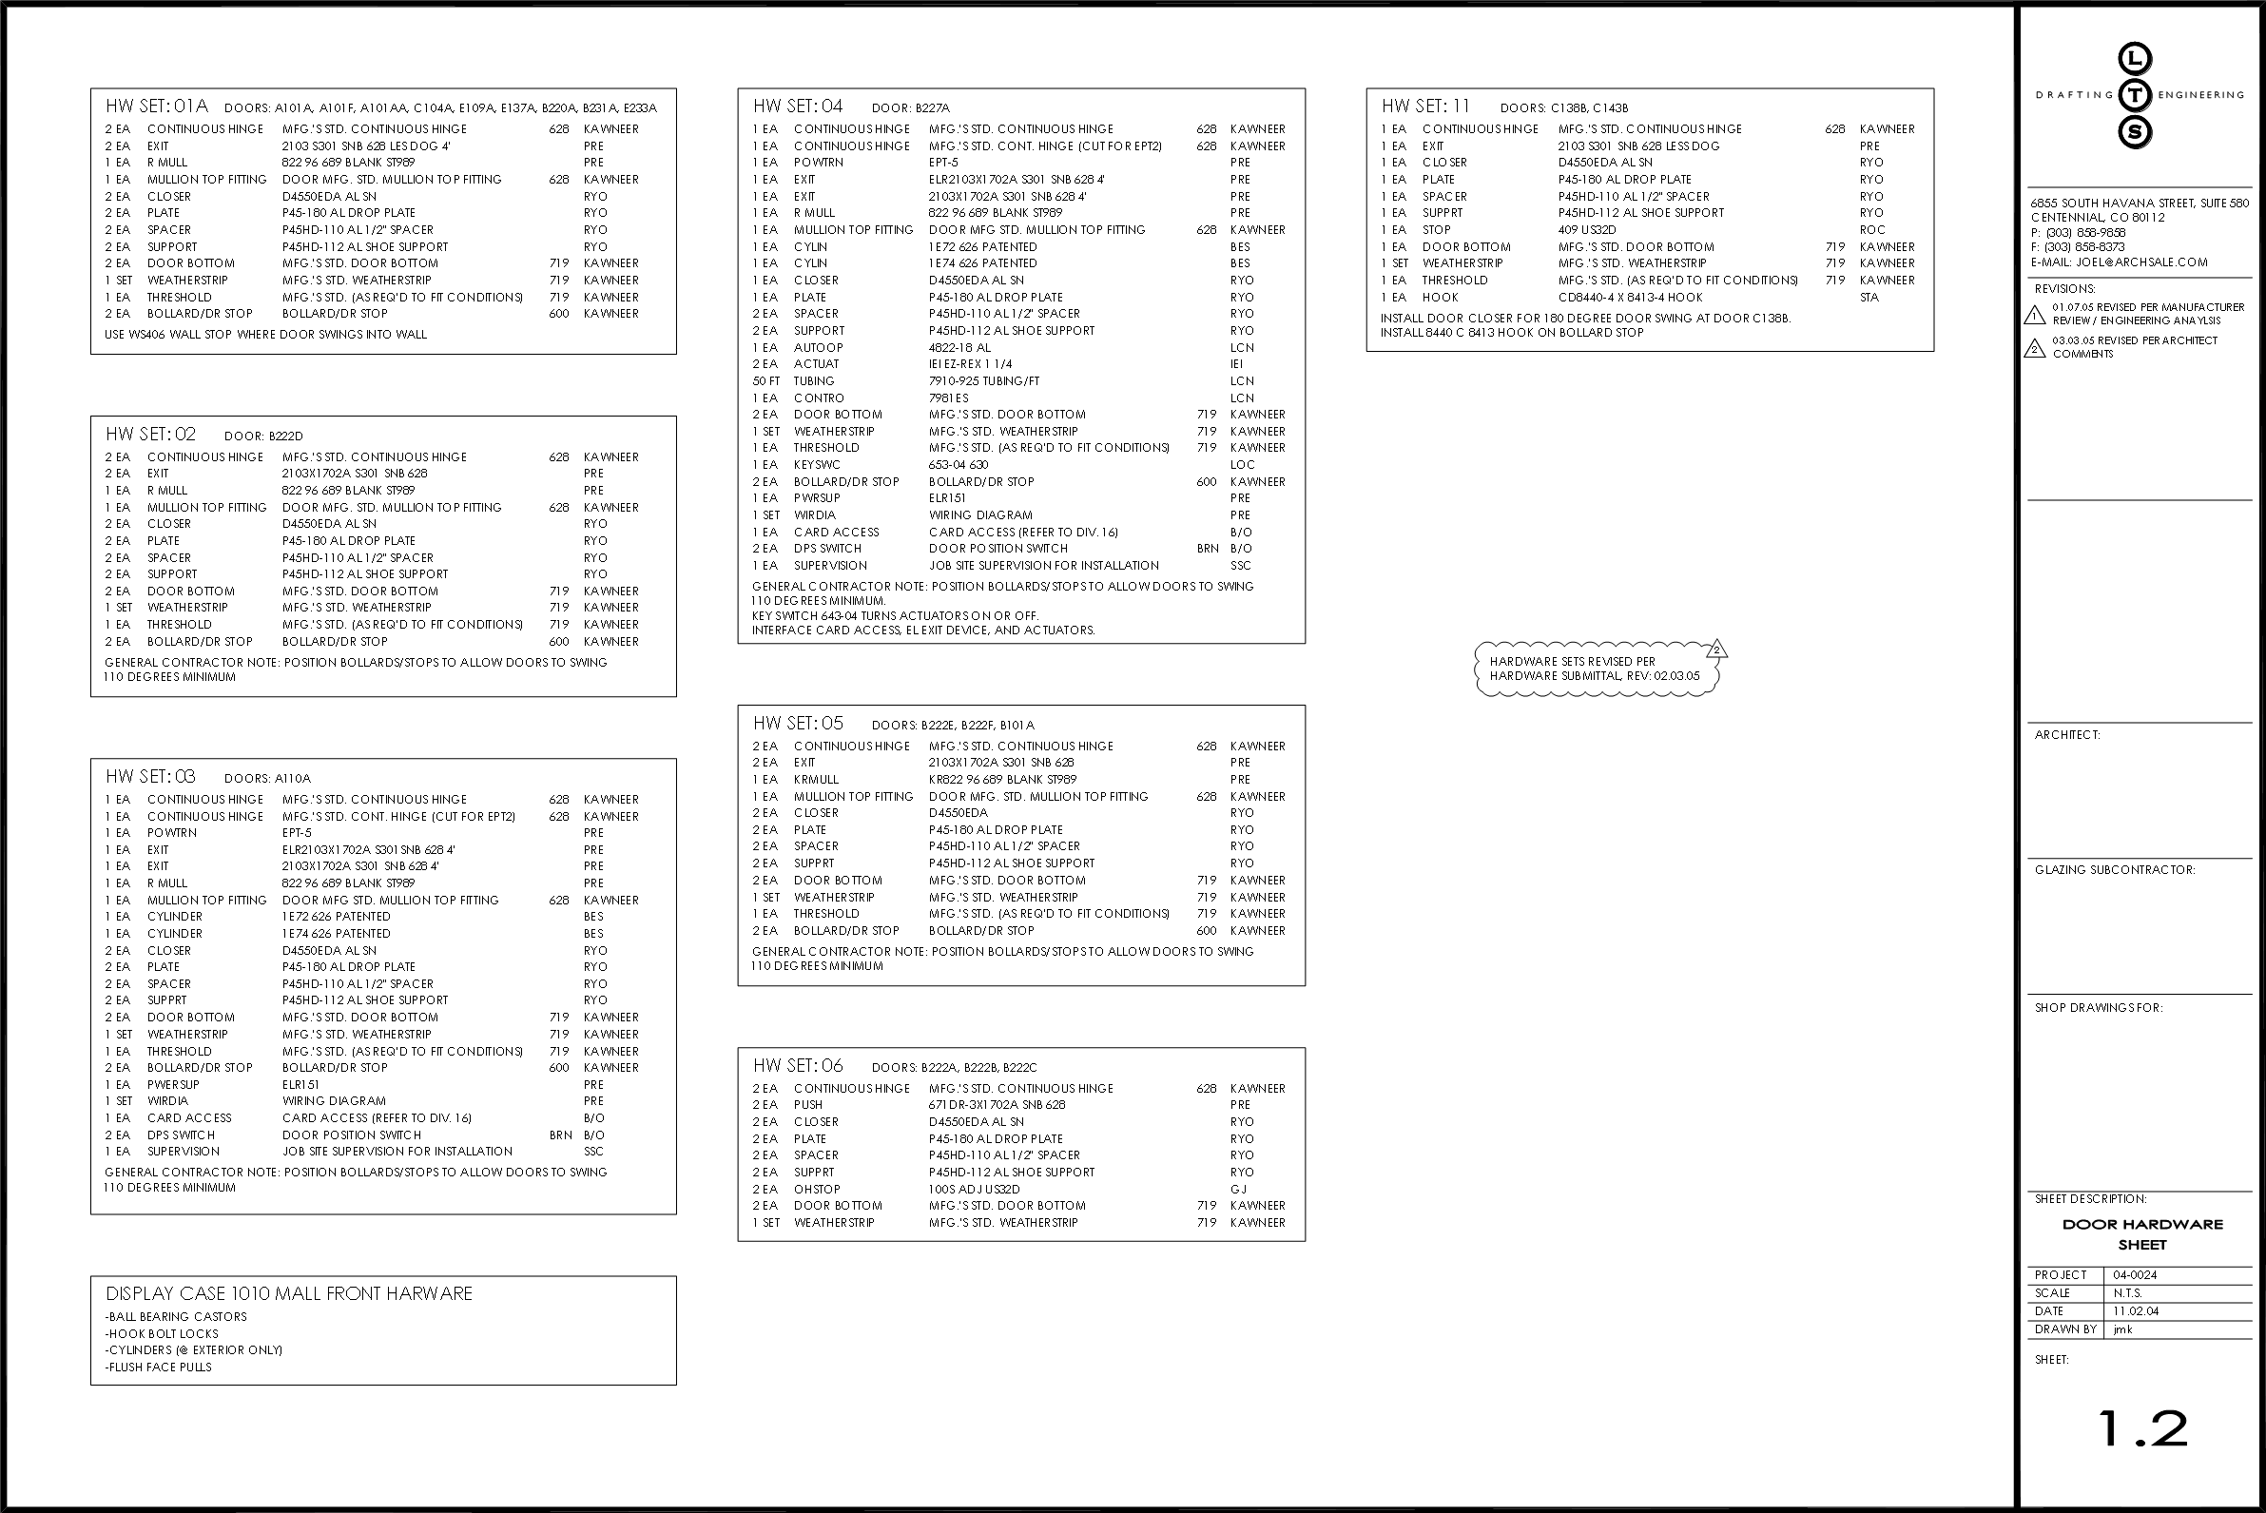

Slide 64
Room Finish Schedule
The room finish schedule gives you the:
Room number or name
Material Key
Manufacturer
Finish
Color
Location
https://productmasterspec.com/construction_specifications?view=10&bim=1&catalog=1

Slide 65
Sample Room Finish Schedule

Slide 66
Equipment or Furnishings Schedules
Some project will have equipment or furniture schedule
Restaurants especially will have equipment schedules
You should have in the field cut sheets for every piece of equipment being installed
Coordinate the cut sheets with the dimensions on the drawings
  Make sure everything will fit

Slide 69
Summary
This session covered:
Architectural drawings
Important information found on certain drawing
Scales
Abbreviations
Reading dimensions
Schedules
Structural Drawings

Slide 70
More information
We will have more training sessions to cover:
Mechanical
Electrical
Plumbing
Structural Steel
Civil

