Slide 1
Submittals, RFIs & Other EOS Items:
A Comprehensive Guide

Slide 2
Submittals

Slide 3
What is a Submittal?
A submittal is a formal document submitted by a contractor or supplier to the architect or project owner for approval. It includes detailed information about materials, products, and systems to be used in the project.

Slide 4
List of Common Submittals:
  Product Data & Cutsheets
  Shop Drawings
  Material Samples

Slide 5
Understanding the Difference
  Product Data: Detailed information about a product's characteristics, performance, and compliance with project requirements.
  Cutsheets: Single-page summaries of product data, often provided by manufacturers.
  Shop Drawings: Detailed drawings or diagrams showing how a product will be installed or integrated into the project.
  Samples: representations of materials to be utilized for the project to be physically reviewed by Architect

Slide 6
Where to Find Required Submittals
Project Specifications
Construction Documents
Past Projects
Industry Standards

Slide 7
Reviewing Submittals Before Submission
Accuracy and Completeness
Compliance with Project Requirements
Appropriate Signatures and Seals

Slide 8
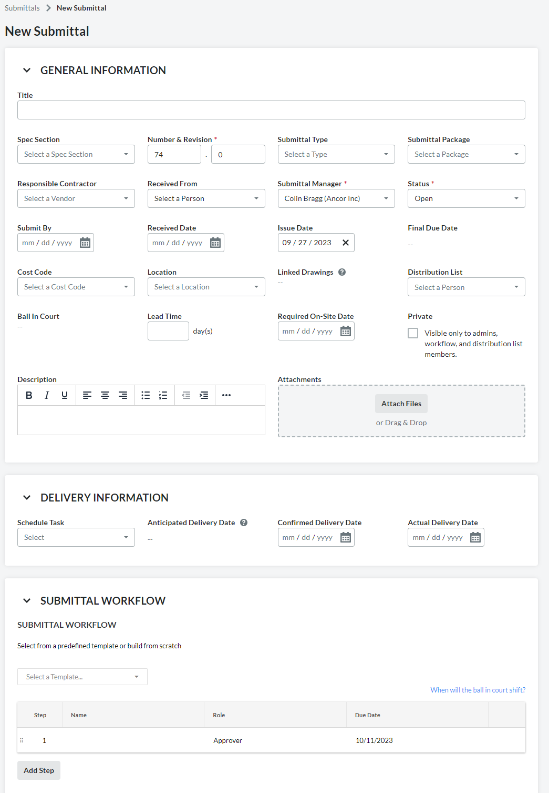
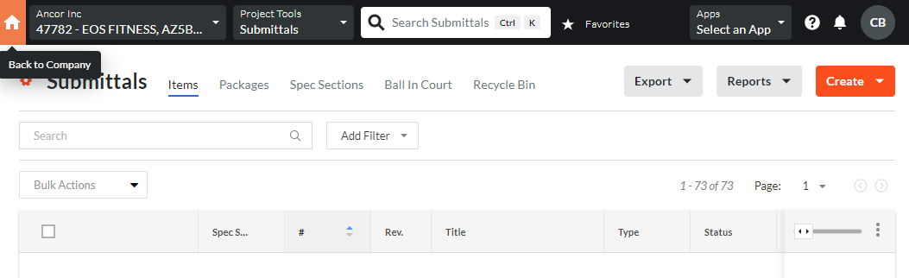
Submission
1 week
A/E

Slide 9
Understanding Submittal Actions
Approved
Approved as Noted
Revise and Resubmit
Rejected
No Action

Slide 10
  Revise and Resubmit
Review responses from architects and engineers
Close and distribute [send] the responses to the project team and submitting subcontractor
Request a revised submittal within a reasonable amount of time (determined by PM)

Slide 11
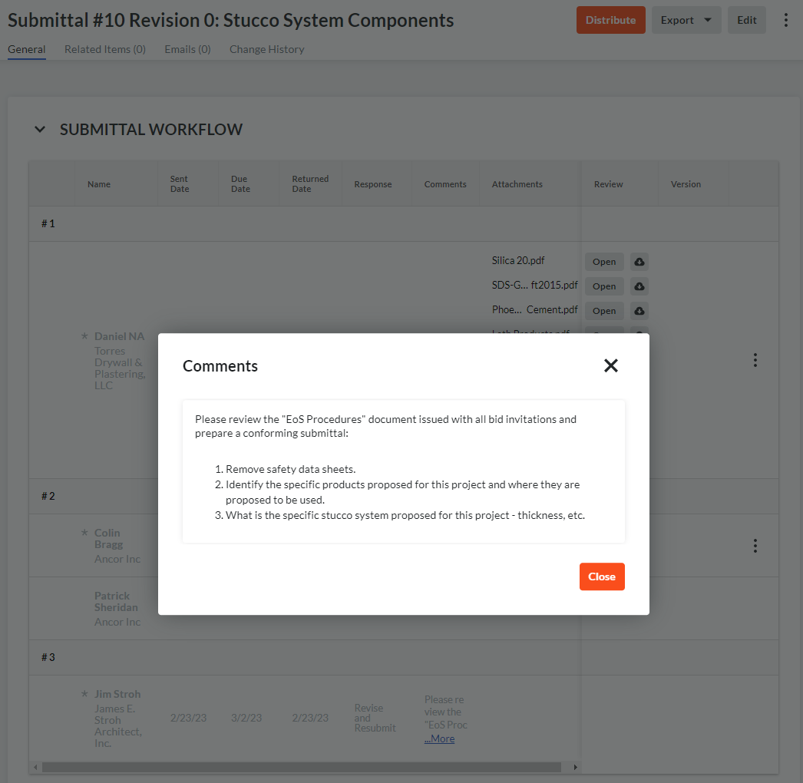
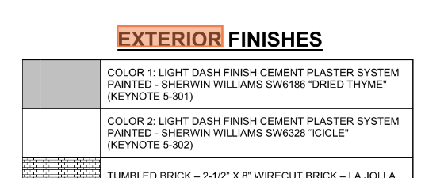
Example 1
A/E’s response
Check Drawings to confirm accuracy.
Stucco is an exterior finish, look for elevation drawings
Cement Plaster System not detailed on finish schedule

Slide 12
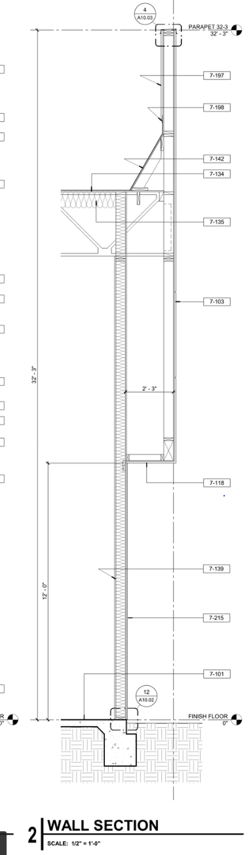
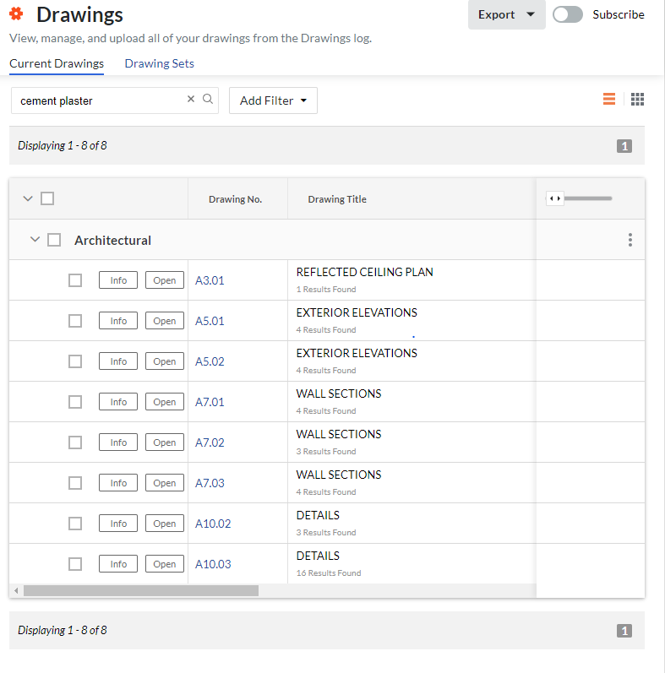
Example 1
Search construction drawings with keywords
Check wall sections as the cement plaster system is a wall component

Slide 13
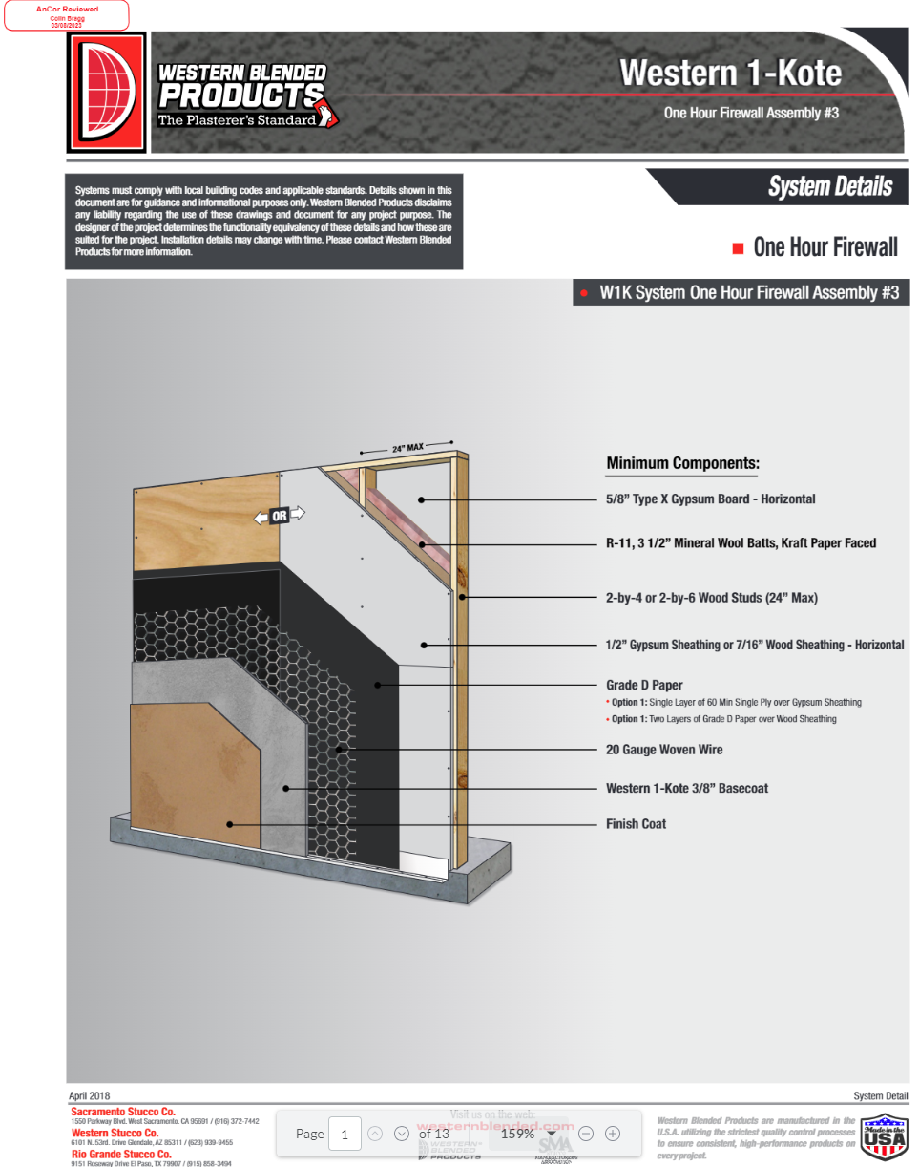
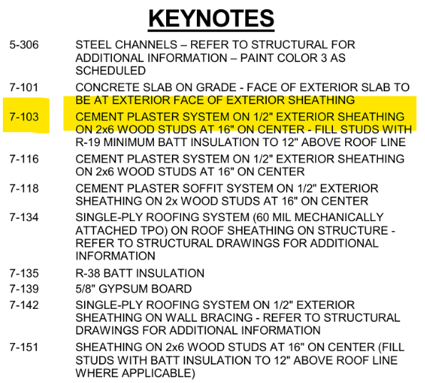
Example 1
Identify that original product data submittal did not
Request system detail from Subcontractor and submit revised submittal

Slide 14
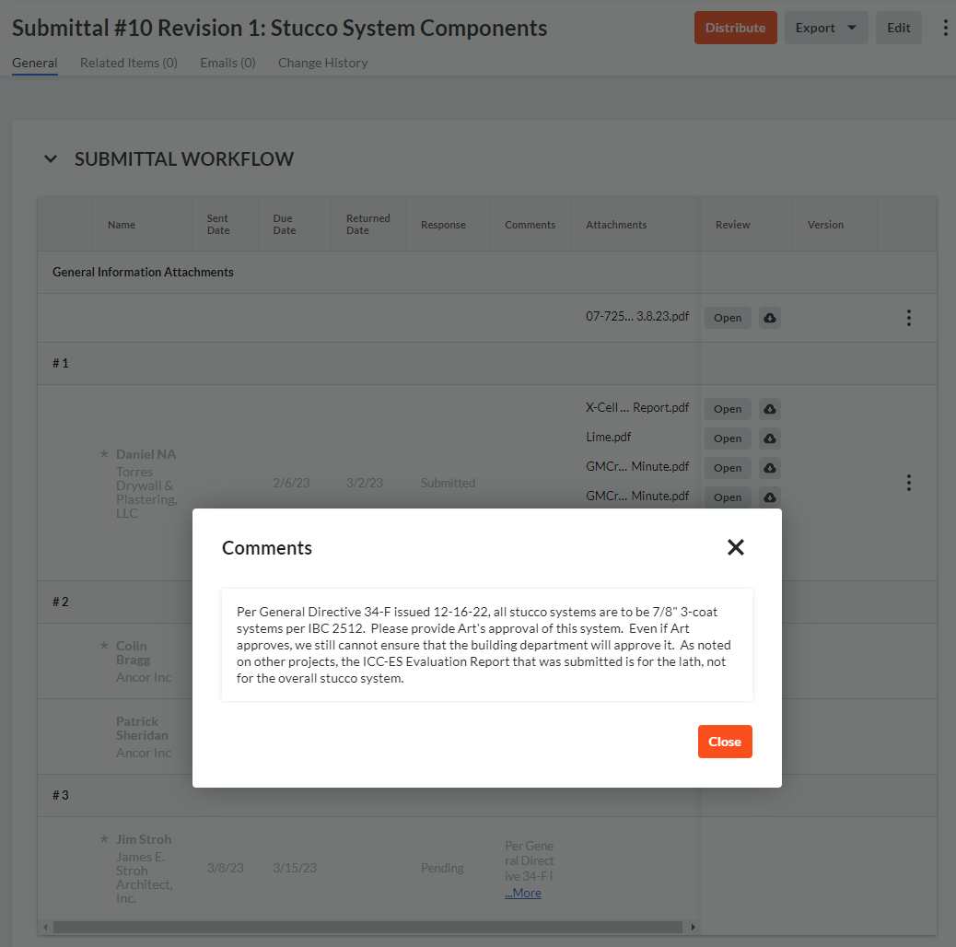
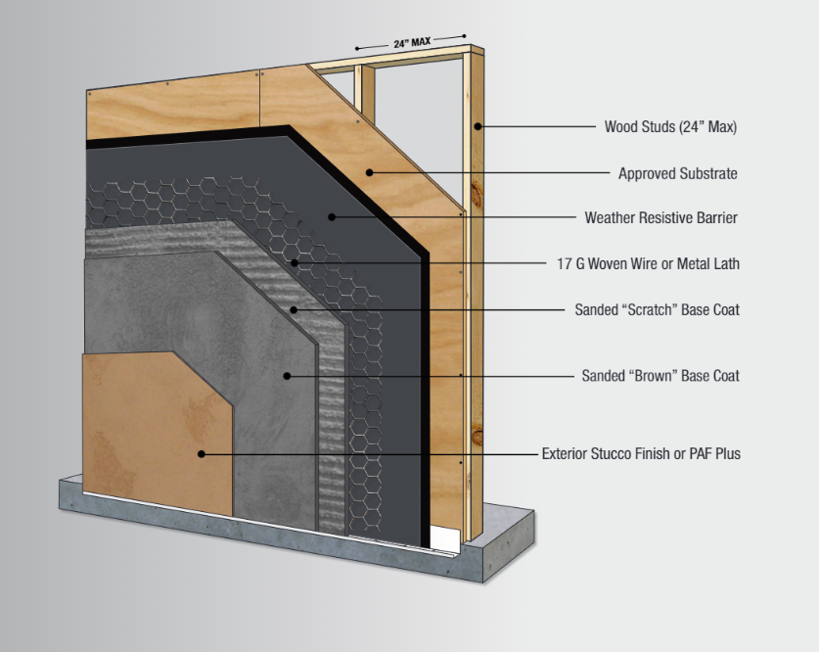
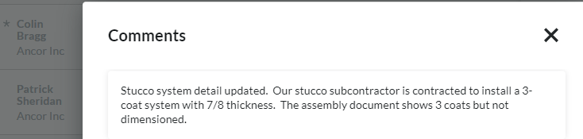
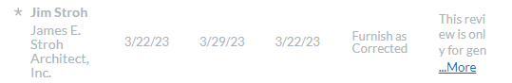
Example 1
System doesn’t meet General Directive #34-F
Subcontractor sends revised stucco component system, again

Slide 15
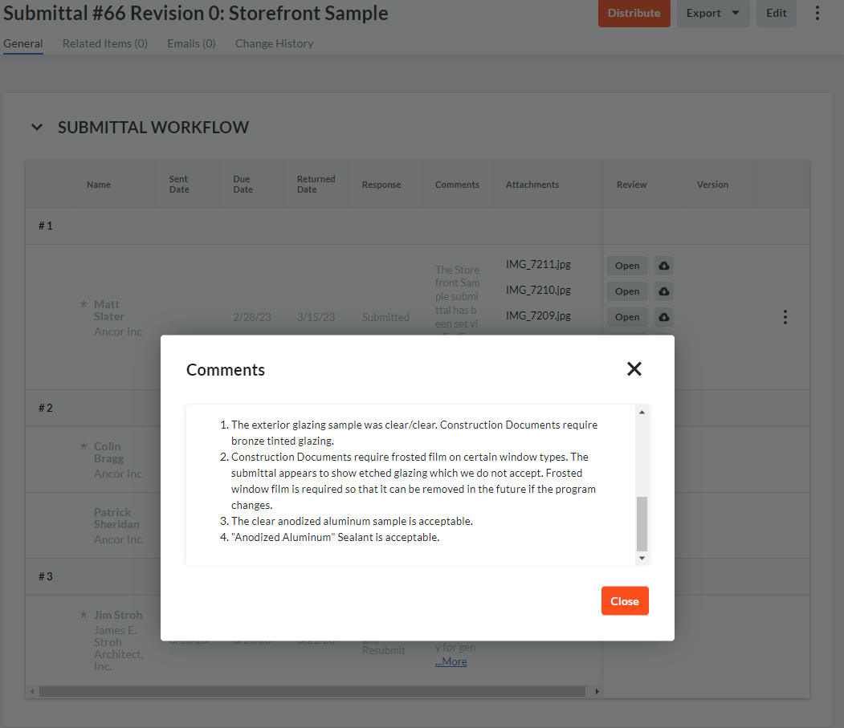
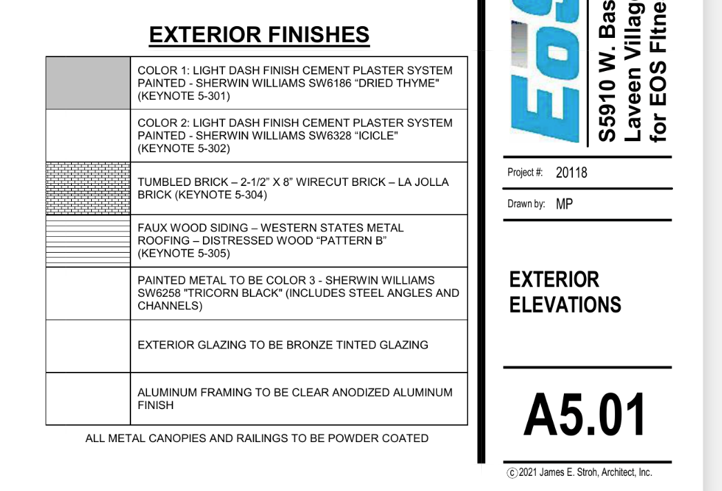
Example 2
A/E’s response
Check Drawings to confirm accuracy. In this example: A5.01 Exterior Elevations

Slide 16
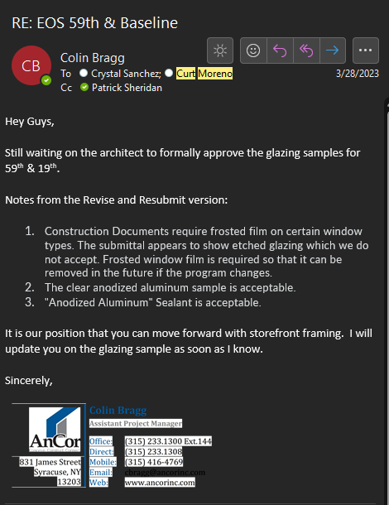
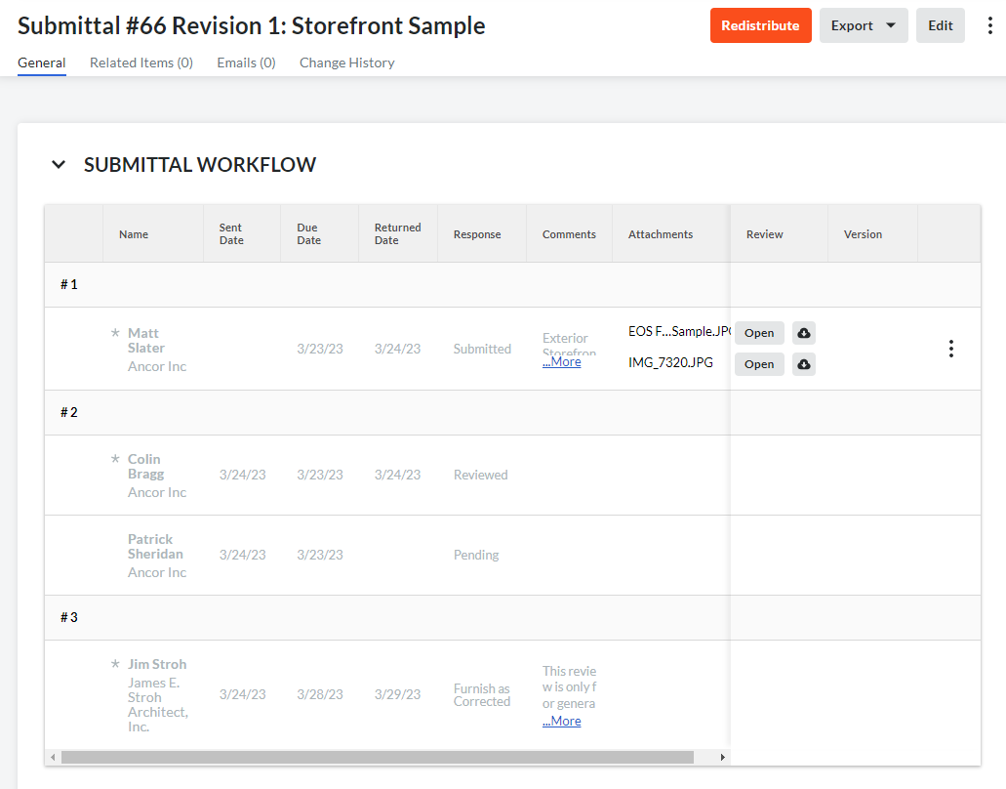
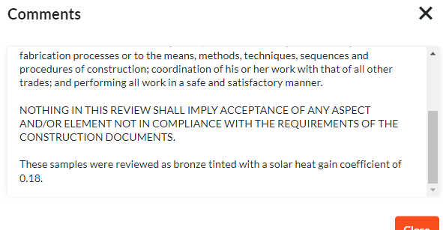
Example 2
Project Team directs subcontractor on required changes
Create revision to closed submittal, attach photo of correct sample, provide tracking & and await approval

Slide 17
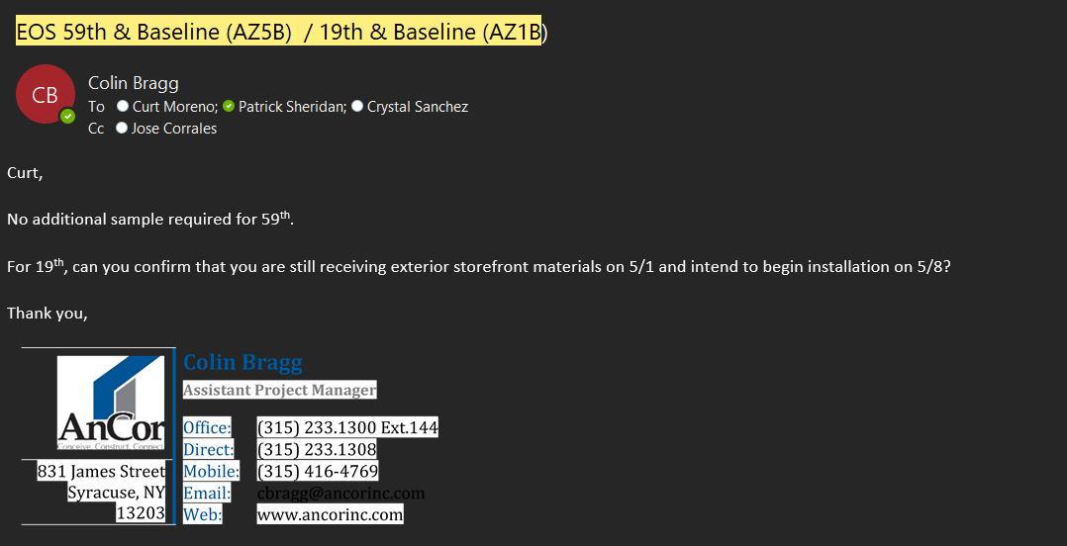
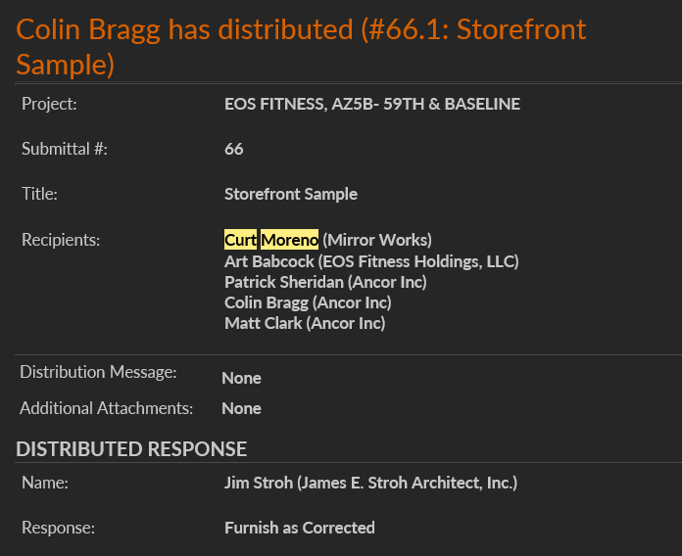
Importance of Submittal Due Dates
Keeps Project on Schedule
Allows Time for Revisions
Prevents Delays and Cost Overruns

Slide 18
Lead Time and Submittal Prioritization
Examples:
Rooftop Units (RTUs): Longer lead times may require early submittals.
E.g. Electrical Gear: Critical path item, prioritize for timely approvals. Lead times 26-52 weeks in year 2023
E.g. Storefront Doors: after approval determined to have 12-week lead time, subcontractor suggested alternate which was submitted and approved for subcontractor to meet dates

Slide 19
RFIs

Slide 20
What is an RFI?
An RFI (Request for Information) is a formal document used in construction projects to seek clarification or request additional information about project details, plans, specifications, or materials. It facilitates communication and resolution of uncertainties.

Slide 21
Contents of an RFI Submission
Key Elements to Include:
Reference Roof Name, Number, Location, and Column Lines.
Photos: Visual documentation of the issue or question.
Marked-up Plan: Clearly indicate the area of concern or inquiry.
Detailed Description: Explain the issue or request for information.
Potential Solution: Offer suggestions or proposed solutions when applicable.

Slide 22
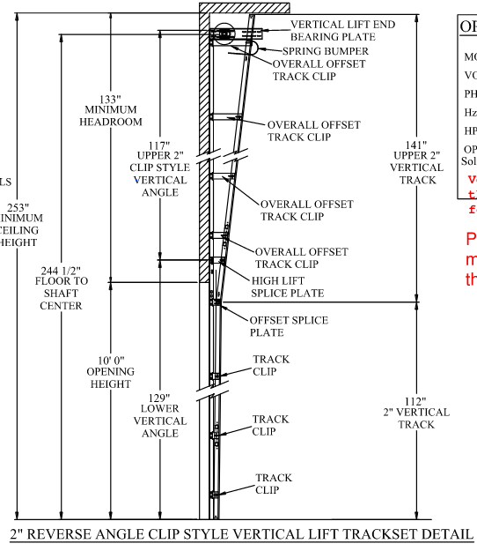
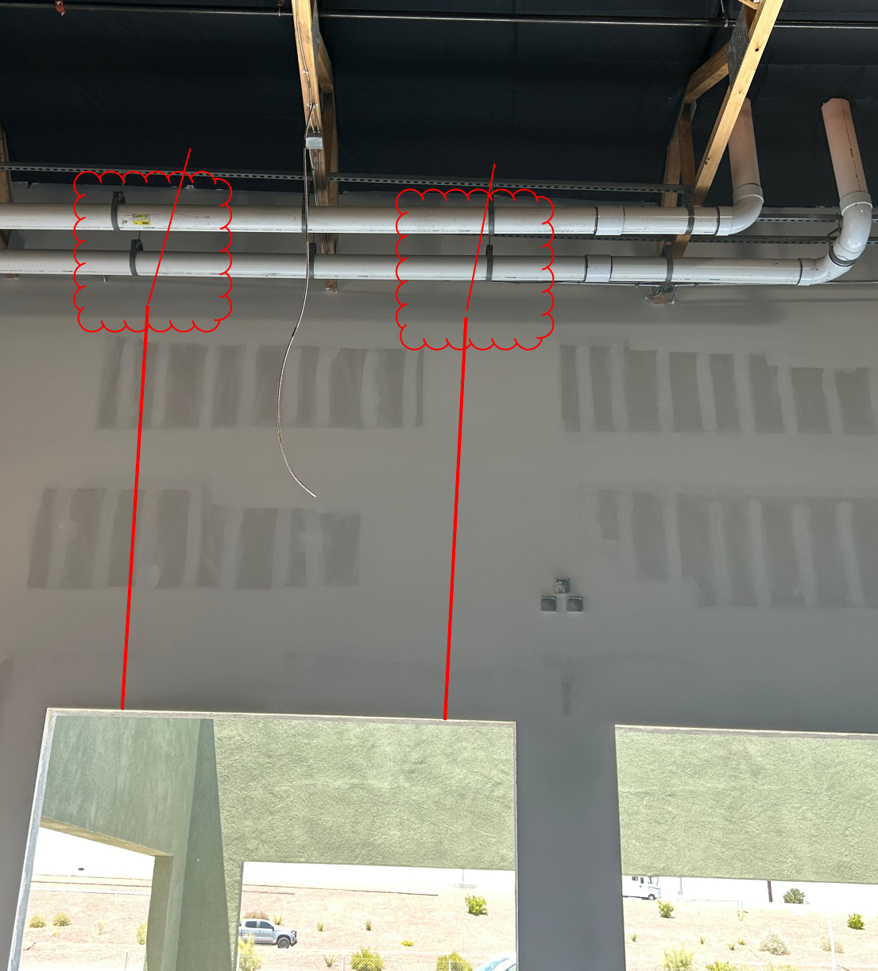
Sample RFI Submission
AZ5B RFI #49: Overhead Door Design Conflict
The overhead door subcontractor called after a site visit and notified us a conflict
with the proposed door design and the already installed roof drain piping.
See Below:

Slide 23
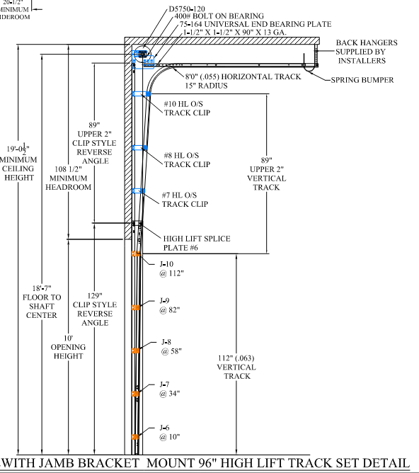
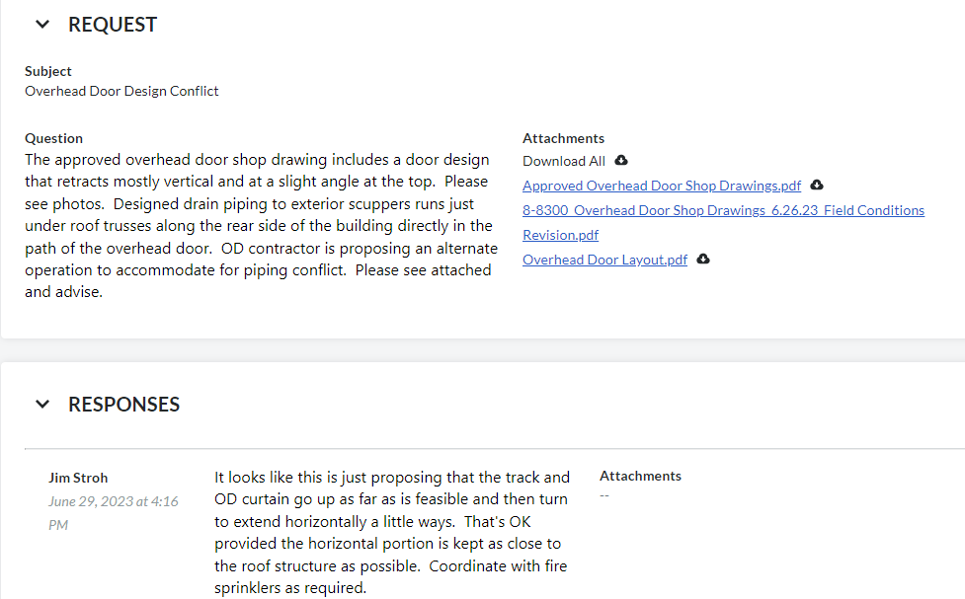
Sample RFI Submission
AZ5B RFI #49: Overhead Door Design Conflict
DH Pace suggested modifying design to
A horizontal track that would retreat below the drain pipes

Slide 24
Distributing RFI responses
Project Team and distribution list are notified of RFI responses by assignees via Procore automated emails
Team member to open RFI in Procore and review response for appropriateness
Close the RFI. The PM should already be distributing or discussing the response with the subcontractor, unless you are directed to do so yourself.

Slide 25
General Directives
Lessons Learned are insights gained from past projects, both successes and challenges, that can be used to improve future projects.
Importance: Tracking issues from job to job and logging them allows for continuous improvement and helps prevent the repetition of mistakes.

Slide 26
Understanding EOS General Directives
EOS General Directives are specific guidelines, policies, or instructions unique to EOS projects.
Location: tracked in the General Directives table found in Procore project: EOS Standards → Documents → #3. General Directives
New directives distributed by JSA via Preconstruction team
Importance: changes to design and implementation not necessarily updated in construction plans

Slide 27
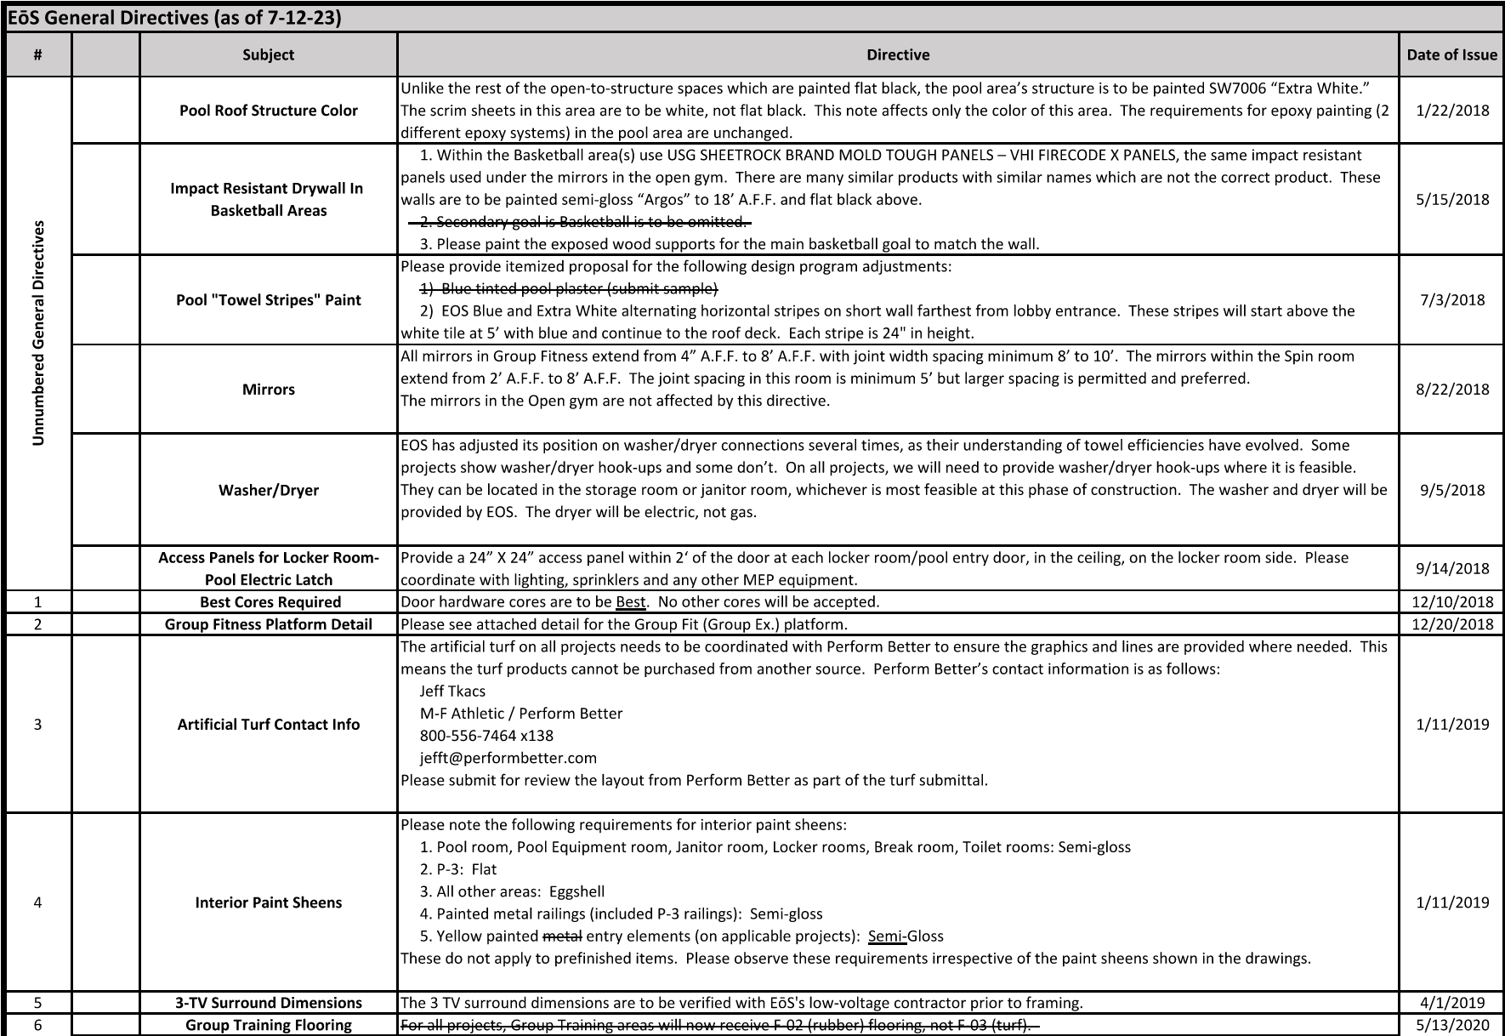

Slide 28
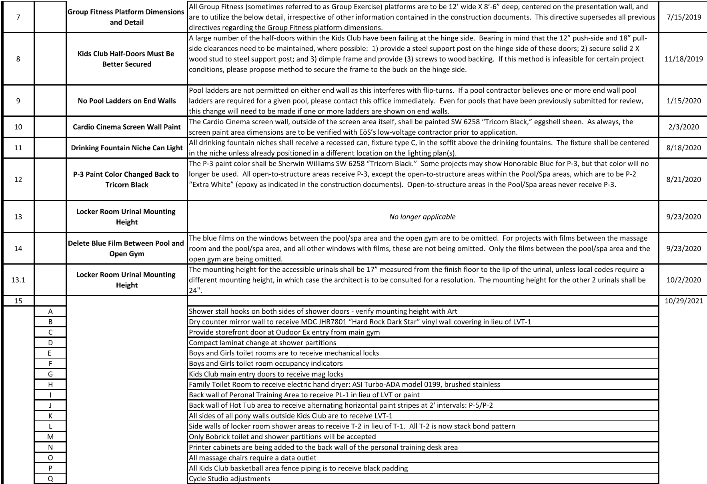

Slide 29
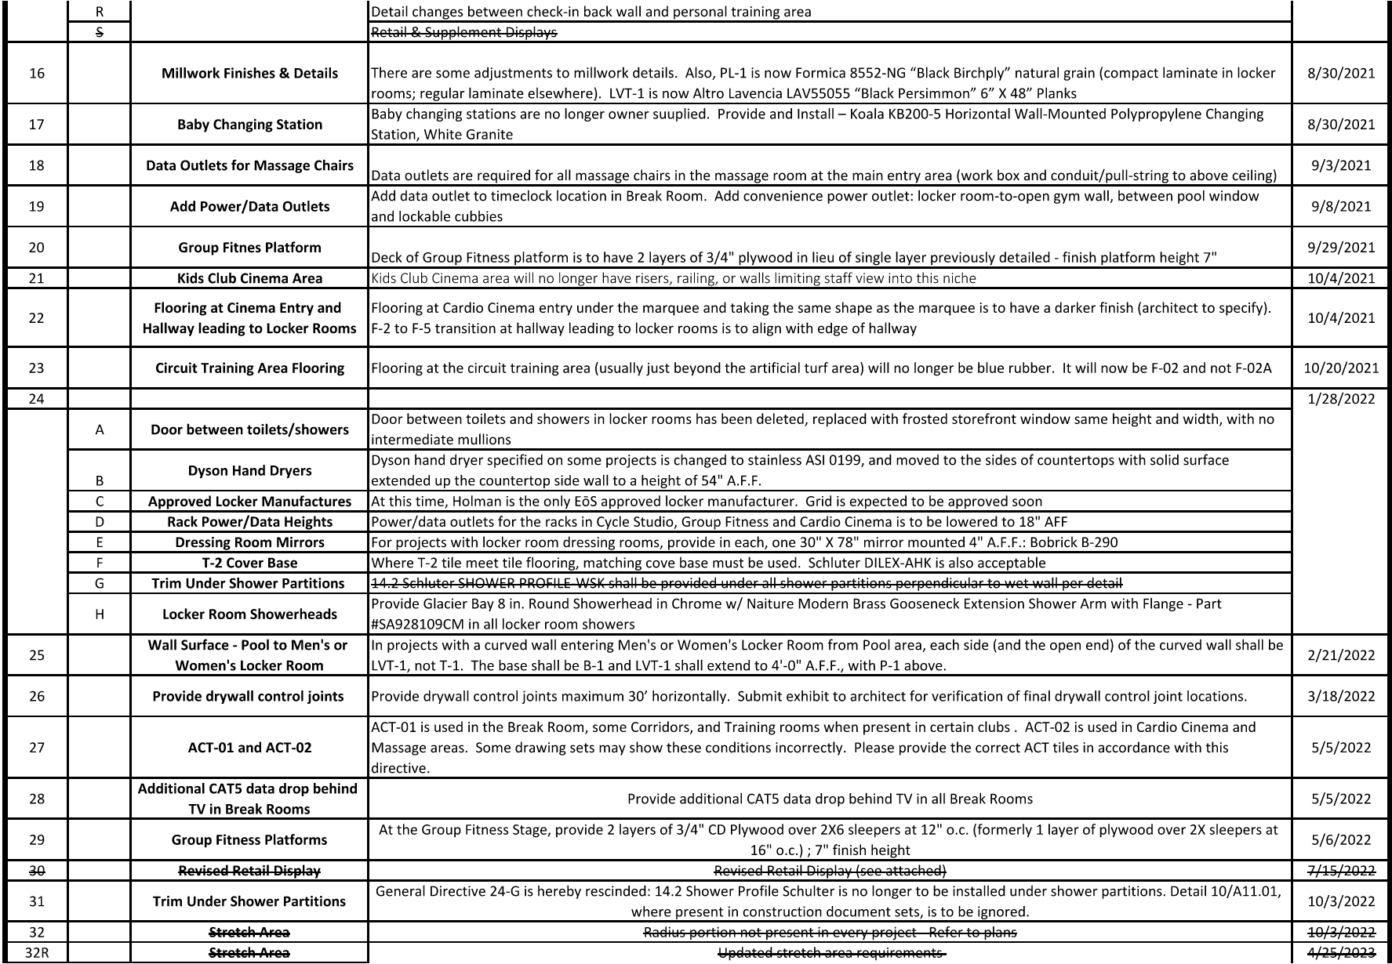

Slide 30
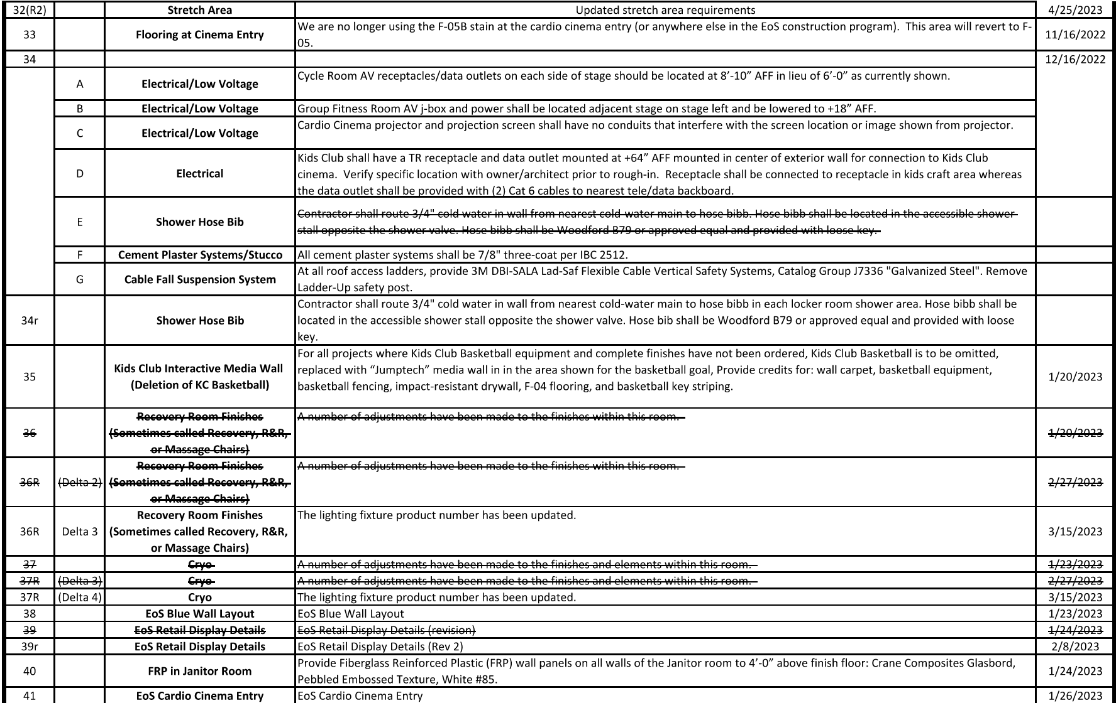

Slide 31
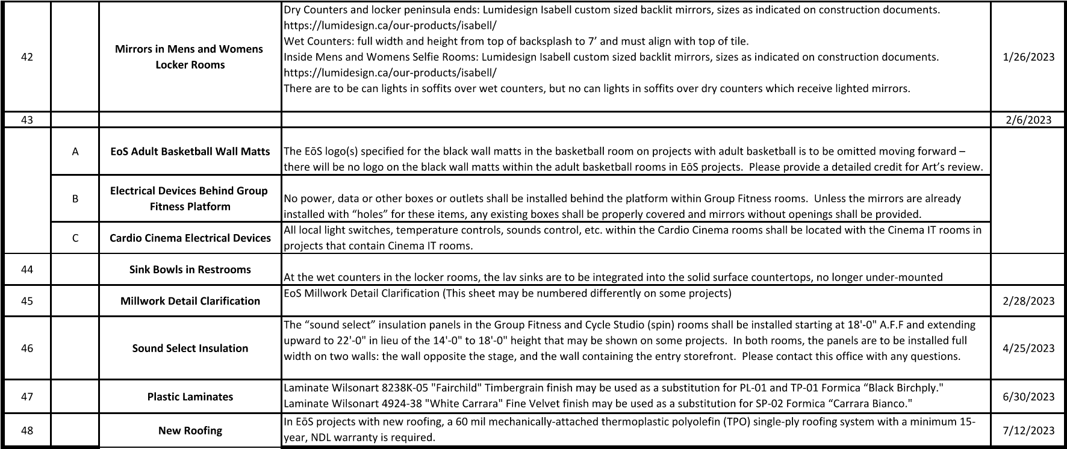
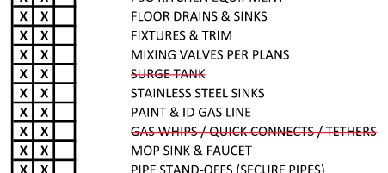

Sinks are no longer the responsibility of the plumber; to be furnished and installed by the millwork sub. Good idea to check PC’s matrix to see if AnCor is owed credit back for F&I steel sinks.

Slide 32
Lessons learned

Slide 33
Lessons Learned table
Lessons Learned are insights gained from past projects, both successes and challenges, that can be used to improve future projects.
Location: tracked in the Lessons Learned table found in Procore project: EOS Standards → Documents → #1. Lesson Learned
Importance: Tracking issues from job to job and logging them allows for continuous improvement and helps prevent the repetition of mistakes.

Slide 34
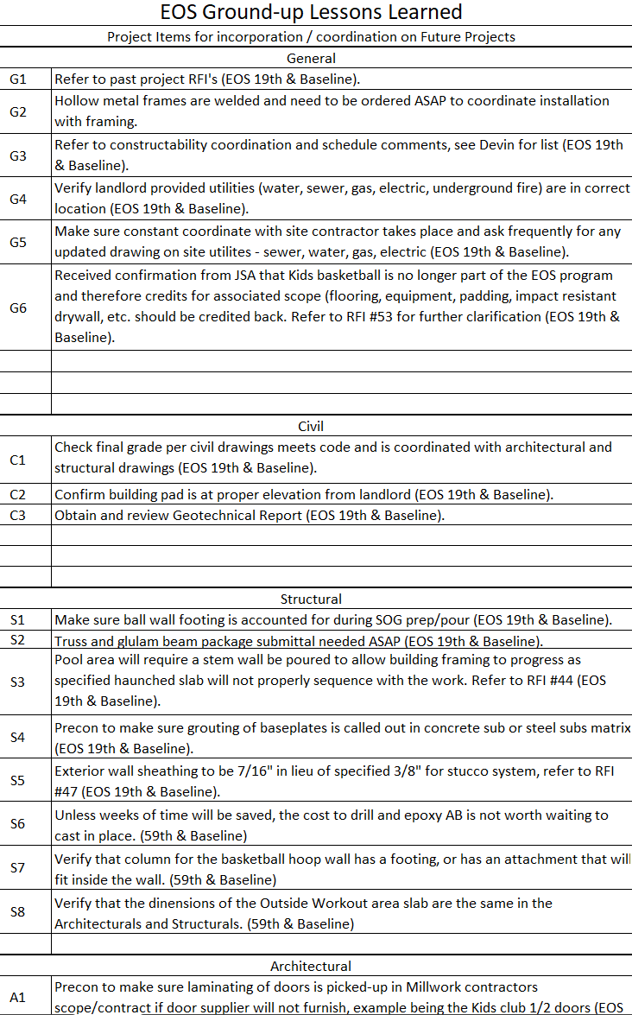

Slide 35
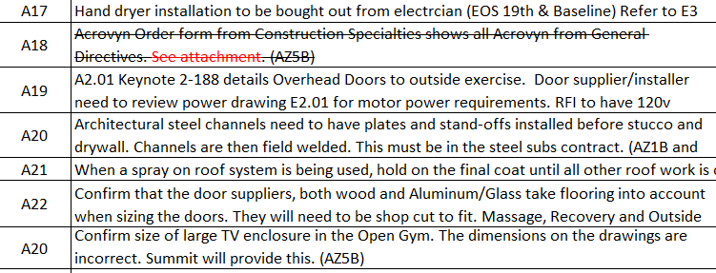

Slide 36
Takeaways
  Submittals & RFIs are essential for project documentation and quality control.
  Understanding submittal types and actions is crucial.
  Meeting submittal due dates & getting RFI answers impact project timelines.
  Lead times affect submittal prioritization.
  Subcontractors need to be reminded of how General Directives affect their scope and project team to ensure they’re implemented correctly
  Team to reflect on project challenges and record in Lessons Learned so i

Slide 37
THANK YOU

